Slide 1
YOUNG PEOPLE IN THE LEAD TRAINING
Modules available in this series:
Module 1: Facts About Care & Custody
Module 2: Trauma Informed Working
Module 3: Building Relationships
Module 4: Developing Independence
Module 5: Spaces & Places
Module 6: Boundaries
Module 7: Consultation & Participation
Module 8: Staff Wellbeing

Slide 2


MODULE 8
Staff Wellbeing
This resource is part of the Informing Futures toolkit www.informingfutures.co.uk It was co-created with young people, and reflects what they felt practitioners most needed to understand in order to work successfully with care and custody experienced young people.
For more information or queries on any of the topics covered in this toolkit, or to find out about training and consultancy we can offer please contact enquiries@1625ip.co.uk
Special thanks to all the young people who took part in YPIL directly or supported our research for these resources: Ahmed, Alexis, Ashraf, Curtis, Ethan, John, Michael, Nikita, Rowen, Tia-Louise, & Tyler-Jack
Copyright© 2020 Informing Futures is a 1625 Independent People project.
Copyright© 2020. Informing Futures, a 1625 Independent People project.
Notes:
INTRODUCTION
This training is based on collective learning from 7 years of trauma informed work with complex young people, and also from our experience of working with partner agencies and practice sharing.
The session aims to introduce the importance of staff wellbeing as a foundation for not only a happy workforce but for effective service delivery. It will not answer everyone’s wellbeing questions, but will provide some tools for starting a process of integrating personal and team wellbeing into your practice.
NOTE: This training takes an asset based approach, asking participants to think about what is good for their wellbeing rather than identifying problems. This is not intended to avoid or deny things that are causing poor wellbeing – but research suggests we are more likely to discover positive solutions when we focus our thoughts on positive things.
For groups who feel stuck in a mindset of identifying negatives, you may want to spend some time addressing this. There is a useful CBT resource to support people to think about changing unhelpful thinking styles here: https://www.get.gg/docs/UnhelpfulThinkingHabitsWithAlternatives.pdf
The Circle of Influence can also be a useful activity to support thinking about what is within our control to change. There is a free guide to using this activity with a group here: https://www.thensomehow.com/wp-content/uploads/2019/06/TS-Circle-of-Influence-Worksheet-2.0.pdf

Slide 3

MODULE 8: STAFF WELLBEING
What is wellbeing?
Why does it matter?
Who is responsible?
What employers can do
What individuals can do
Supporting one another – team wellbeing
Notes:
Introduce the topics to be covered in the session, using the bullet points on the slide.
Ice breaker/movement – if room and time allows, get people to move around the room and segment themselves into groups as a warm up exercise.
You could base these on wellbeing issues, eg:
Two groups - who had breakfast before they left the house this morning and who didn’t (of those who didn’t, hands up who would have preferred to but just didn’t have time)
Or use questions which help the group think about the composition of their team, eg:
Arrange yourselves in order of the length of time you have been in your current role (Check what is longest, what is shortest)

Slide 4
WHAT IS WELLBEING – DEFINITIONS & MEASURES
The World Health Organisation (WHO) defines health as
‘a state of complete physical, mental and social wellbeing and not merely the absence of disease or infirmity’ (WHO, 1948)
Personal Wellbeing Index – measures satisfaction with life across 7 domains. Developed in Australia and used in 50 countries around the world
Standard of living • Health • Achieving in life • Relationships •Safety • Community connectedness • Future security •Spirituality/Religion
WHO-5 I Focuses on how the participant has felt over the past 2 weeks:
I have felt cheerful and in good spirits • I have felt calm and relaxed • I have felt active and vigorous • I woke up feeling fresh and rested • My daily life has been filled with things that interest me
Notes:
The concept of wellbeing is not new – the WHO definition dates to 1948
For employers and organisations, measures can be a useful way to assess wellbeing and a first step to understanding and improving it
Governments are interested in wellbeing as a public health indicator – UK government carries out a national satisfaction survey which can be accessed on the ONS website.
There are many ways to measure wellbeing and satisfaction – for individuals, there is something important about identifying a way of thinking about wellbeing which makes sense to you. This can be challenging when most measures are designed to be used over a large group.

Slide 5

WHAT IS WELLBEING
Notes:
An internet image search might give you quite a different idea of what wellbeing is about. It seems to involve pebbles, sunsets, being outdoors, and doing yoga… there are also a multitude of diagrams featuring hands, leaves, apples and trees!
Optional discussion point: What image would you choose to represent wellbeing?

Slide 6

WHAT DOES WELLBEING MEAN TO YOU – EXERCISE
Exercise: 5 minutes
In small groups, mind map the things that you need for your wellbeing.
There are no wrong answers!
Notes:
Resources: Flipchart paper, felt pens, sets of highlighters
Optional resources: It can help to have some sensory items on each table for people to play with, to prompt thinking about wellbeing. Think about what would be appropriate for your group – but these could include: Stress balls, tangle toys, play doh or slime, hand cream, natural scents (try essential oils, dried lavender or rose petals), mindful colouring books & pencils, blankets or throws, plants or fresh flowers, fresh water, chocolate or fruit.
Invite groups to feedback informally on what is on their mindmaps. Hearing feedback and ideas from others is often one of the most useful parts of training.
Note any common themes or priorities.

Slide 7

WHAT DOES WELLBEING MEAN TO YOU – EXERCISE
In small groups, mind map the things that you need for your wellbeing.
There are no wrong answers!
How does your map relate to the 5 ways to wellbeing defined by the NHS?
Notice whether you are drawn to one of these areas particularly.. That might mean it is important to you at the moment
Notes:
Start by explaining the 5 ways to wellbeing – this is the framework used in the NHS and many other agencies in the UK to help people think about the things that benefit their wellbeing.
The five ways are summarised in the graphic on the slide.
You can either:
have groups just discuss whether the elements on their mind map fit into these categories
Or:
give them markers so they can colour code the elements.
If using the colour coding part of the exercise, you will need highlighters corresponding to the colours in the graphic above
Accessibility – check if anyone in the group is colour blind as this exercise could be frustrating for them !
In either case, check if the groups have identified other categories they feel are important which aren’t captured in these 5 domains.
Emphasise that all wellbeing measurement tools are just that – tools – and everyone will be different in terms of which ones they find helpful personally.
Invite feedback on which areas seem most important to each group. Are any particularly deficient?
Hold onto your mindmaps – you will need them later in the session.

Slide 8
WHY DOES WELLBEING MATTER?
Social care, health & education sector had the highest sickness rate in the UK at 4.4 days per worker per year
(2017 figures from ONS)
Over 11 million days a year are lost at work due to stress
(www.hse.gov.uk 2020)
The estimated cost to the UK economy in lost productivity was £18 billion in 2017 (Centre of Economic and Business Research)
The UK national satisfaction index suggests that 56% of people are mostly or completely satisfied with their job – meaning a significant 44% are not
(ONS National Wellbeing Dashboard 2016/17)
Notes:
Having thought a bit about what Wellbeing is, let’s think about why it is important.
These stats give an overview of the UK picture. But poor wellbeing also has drastic personal consequences and can lead to deteriorating mental and physical health which impacts on individuals, their families and communities in ways which cannot easily be measured.

Slide 9
WHY DOES IT MATTER TO US?
Reflecting on those stats in a team context might mean:
In a team of 8 people, 3.5 of them are not happy at work
The same team could gain an extra 35 days a year if everyone was well
We could save 1.4 billion across the UK voluntary sector
Of course, these are estimates… but they demonstrate the difference good wellbeing could make to our jobs.
Notes:
It’s not just about feeling happy! (Although that is nice too)
Based on the statistics on the previous slide, here are some ways to think about the difference good wellbeing might make in a typical team.
Imagine if your team could have an extra 7 weeks to get everything done next year – or a share of the 1.4 billion.
We often identify time and money as resources that we need more of – so it makes sense to conserve them by looking after ourselves and each other properly!

Slide 10

WHO IS RESPONSIBLE?
Your employer has a legal duty to identify anything which could harm you in your job and take precautions to prevent it. This includes work related stress.
Your employer must share this information with you, and if the company has more than 5 employees, must provide a written record of it.
Notes:
More info on the legal responsibilities of employers and employees in the UK can be found at www.HSE.gov.uk
Show of hands – who thinks employers could or should do more than they currently do to protect worker wellbeing?

Slide 11

WHO IS RESPONSIBLE?
As a employee, you must:
Take reasonable care of your own health and safety.
Co-operate with your employer on health and safety – for example following training or procedures which are in place for your safety or wellbeing.
Tell someone if you think anyone’s health or safety is at risk due to the work or inadequate precautions.
‘Take reasonable care of your own health and safety’
This is your rationale for including wellbeing awareness and wellbeing activities into your work culture – use it!
Notes:
There is a perception that health and safety only applies to our physical health and safety – but in fact the HSE recognise stress as a major factor which impacts on health, and provides lots of guidance for employers and employees to help prevent and manage stress at work.
In the voluntary sector we often have to consider the mental wellbeing of our service users – do we give the same consideration to our own needs and those of our colleagues?
Similarly – we would report dangerous use of a chainsaw – but do we think in the same way about the dangers of overwork, stress and secondary trauma?
Show of hands – who thinks individuals could or should do more than they currently do to protect their own wellbeing?

Slide 12
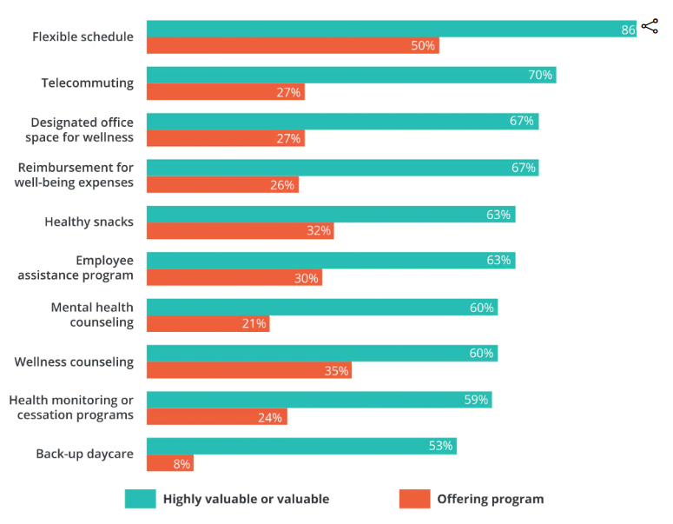
WHAT EMPLOYERS CAN DO
Employers are increasingly offering a range of benefits under the umbrella of wellbeing – but research suggests they aren’t always effectively matched with what employees want.
A good first step for any employer wanting to improve workplace wellbeing is to survey their workforce effectively – and be prepared to listen to the responses.
Source: Global Human Capital Trends 2018
Notes:
Unhappiness at work can often lead to a feeling of disempowerment, so finding positive steps to take can be really important.
Employees who are experiencing high dissatisfaction could suggest an employee wellbeing survey to their employer as a constructive first step towards improving an unhelpful work culture.
The Global Human Capital Trends survey would also make useful reading for an employers who need convincing to take wellbeing seriously.
If time allows, can do ‘show of hands’ exercise on the list of measures above to see if there is a clear identifiable priority which appears in this list for this group

Slide 13




WHAT CAN WE DO
Take some times for ourselves
Notes:
Resources: Wellbeing at Work Audit Sheet, pens, coloured pens or pencils
Ten minutes to think, reflect, doodle with a focus on your wellbeing.
Spread out around the room or move into another space if you want to.
Use one or other of the wellbeing audit tools provided if they are useful. You won’t be asked to share these with anyone else although of course you can choose to if you wish.
When we come back, we’re going to think about what we can do as teams or groups to support wellbeing – but this time is just about you.

Slide 14
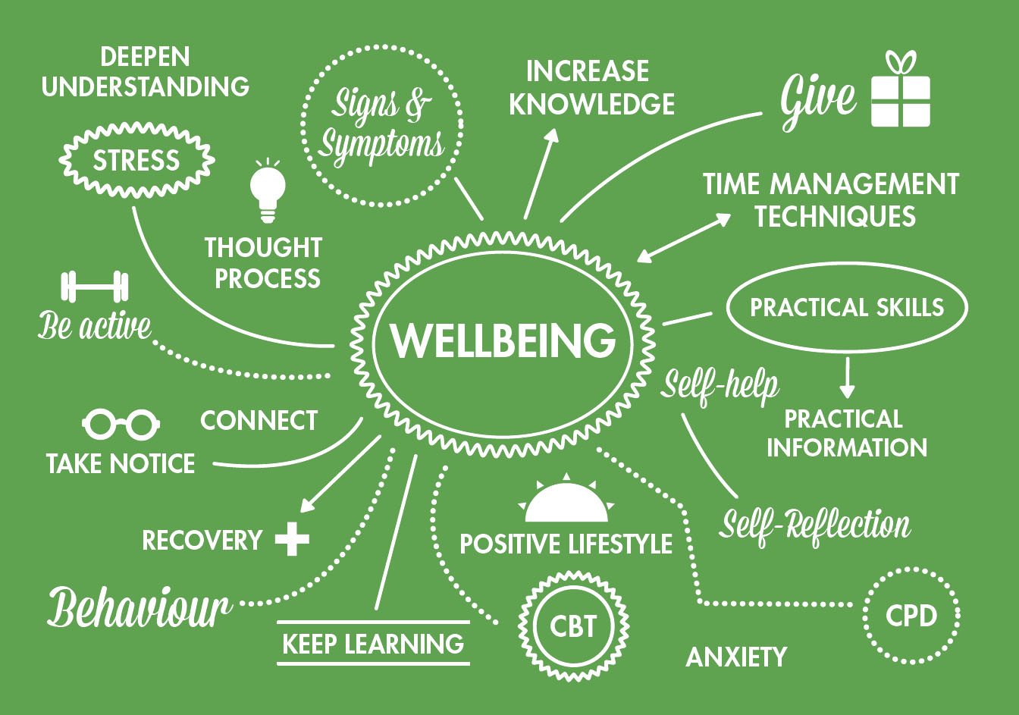
WHAT WE CAN DO – MIND MAP REVIEW
Exercise: 10 minutes
Using the mind maps you created earlier, how many ideas can you generate which would bring the wellbeing elements you identified into your workplace?
https://pharmacistsupport.org/
Notes:
In small groups, go back to the mindmaps you created earlier.
Consider the wellbeing assets you have listed here. Try and find as many creative ways that these wellbeing elements could be brought into your workplace, or your work routine.
It doesn’t matter initially if some of these ideas sound wacky or unlikely – put them down anyway!

Slide 15

WHAT WE CAN DO – MIND MAP REVIEW
Exercise: 5 minutes
Create two lists:
actions you could take
changes you could suggest/request from your employer
https://kycourtreport.com/
Notes:
In small groups, go back to the mindmaps you created earlier.
Consider the wellbeing assets you have listed here. Try and find as many creative ways that these wellbeing elements could be brought into your workplace, or your work routine. It doesn’t matter initially if some of these ideas sound wacky or unlikely – put them down anyway!
Once you have all your blue sky suggestions, create two lists
If you have time, agree as a group at least one item from one list which you are going to commit to taking right away. Set yourselves a deadline!
Invite groups to share their best idea if they wish

Slide 16
TEAM WELLBEING - EXAMPLES FROM OTHER WORKPLACES
Taking it in turns to bring home-made bakes to team meetings
Ten at ten – a weekly check in with a peer from your team to download concerns ahead of the weekend, Friday mornings at 10am
In a workplace with no proper break room – placing a table & couple of chairs in a quiet area by a window, adding paperbacks, a fruit bowl and a plant
Offering the option of ‘walking supervisions’ when the weather is fine
Undertaking a team fitness challenge to raise money for a local charity
Creating a ‘compassion kit’ for the team to use on tough days – made up of items which the team have identified as being helpful to their wellbeing
Notes:
There is no one ‘right’ way to support team wellbeing – but some themes emerge from the wellbeing actions which have been found to be successful – they often promote better communication or greater understanding of one’s colleagues, and involve an element of give and take which is empowering and inclusive.
Talk through the simple examples given above. Note most of these involved minimal financial resources and did not need ‘permission’ to implement.
It is important they come from the team, and are not ‘imposed’ from above.

Slide 17

WELLBEING ON THE AGENDA – SUGGESTIONS FOR MANAGERS
Consider tools which help identify colleagues values and preferences – free online resources: https://www.viacharacter.org/survey/account/register
https://icould.com/buzz-quiz/
Make time - Add wellbeing as an item to all supervisions and team meeting agendas
Model good practice – what you do is more powerful than what you say
Consider tools such as reflective practice to support building wellbeing long term
Notes:
Check if any managers present – include anyway, discuss if people would feel able to make suggestions to their managers?
Values –we sometimes feel we have to assume a ‘work identity’ in order to fit in – and this may be different from who we are outside of work. This is OK to a point – it is important to be professional after all – but when people are very unhappy in work it is often because they cannot reconcile their personal values with the culture in their workplace or the values which inform their organisation. Taking a values survey as a team can offer a great way to think about how personal and corporate values connect, and acknowledge and work through areas where they may seem at odds.
VIA and buzz quiz – surveys can be a fun way to help understand difference and highlight strengths - always check them out yourself first though to ensure they are the right tone for your team
Wellbeing as agenda item – you have to make space for it in order for your teams to feel able to tackle it. Don’t panic if it takes a while before people raise anything. It should become as routine as checking about safeguarding or health and safety.
Good practice – if you are always eating your lunch at your desk while answering emails with the other hand, don’t expect your team to do anything different. Prioritise your wellbeing and be a role model for good self care.

Slide 18

WELLBEING
Let’s keep you that way
Notes:
Hopefully this short session has
helped you to start the process of thinking about your wellbeing at work
Convinced you that your wellbeing is important enough to spend time on
Empowered you to make changes to support better wellbeing for you and your colleagues
Remember – it’s not a one time fix. Make it a habit to take care of your wellbeing forever.

Slide 19
FURTHER READING & RESOURCES
Promoting Emotional Wellbeing in Early Years Staff: A Practical Guide for Looking after Yourself and Your Colleagues https://www.amazon.co.uk/dp/1785923358?_encoding=UTF8&isInIframe=0&n=266239&ref_=dp_proddesc_0&s=books&showDetailProductDesc=1#product-description_feature_div
HSE Website
#Workright - information and resources on tackling stress at work, including a series of short videos https://campaigns.hse.gov.uk/go-home-healthy/work-related-stress/
Talking Toolkit - http://www.hse.gov.uk/stress/assets/docs/stress-talking-toolkit.pdf
Management Standards – an approach for managing stress in the workplace
http://www.hse.gov.uk/stress/standards/index.htm
Informing Futures Toolkit – www.informingfutures.co.uk
Mind Wellness Action Plan – free to download guides for employees and managers https://www.mind.org.uk/workplace/mental-health-at-work/taking-care-of-your-staff/employer-resources/wellness-action-plan-download/
Self help resources – free to download https://www.getselfhelp.co.uk/selfhelp.htm
Notes:
There are many free resources available to help with different aspects of improving wellbeing. The HSE website is an excellent source for managers and leaders looking to find guidance on processes for managing stress proactively

Slide 20
QUESTIONS?
Thanks for listening
Copyright© 2020. Informing Futures is a 1625 Independent People project. 1625 Independent People is a charity and a registered society (Co-operative and Community Benefit Societies Act 2014, reg: 23964R exempt from registration with the Charity Commission). Registered office: Kingsley Hall, 59 Old Market Street, Bristol, BS2 0ER.
This resource was funded by The National Lottery Community Fund and is offered free for information, educational and professional development purposes • You may not sell this work, nor may it be used as supporting content for any commercial product or service • All copies of this work must clearly display the original copyright notice and Informing Futures website address • Any on-line reproduction must also provide a link to the Informing Futures website.
Notes:
Use this time to collect feedback on the training and think about what you would like to take forward from it. Wellbeing is a huge issue, so there will certainly be something you can do in your team or organisation which will progress this work in a meaningful way. Taking the time to identify that now means it is more likely to become a reality.

