Slide 1
YOUNG PEOPLE IN THE LEAD TRAINING
Modules available in this series:
Module 1: Facts About Care & Custody
Module 2: Trauma Informed Working
Module 3: Building Relationships
Module 4: Developing Independence
Module 5: Spaces & Places
Module 6: Boundaries
Module 7: Consultation & Participation
Module 8: Staff Wellbeing

Slide 2


MODULE 7
Consultation & Participation
This resource is part of the Informing Futures toolkit www.informingfutures.co.uk It was co-created with young people, and reflects what they felt practitioners most needed to understand in order to work successfully with care and custody experienced young people.
For more information or queries on any of the topics covered in this toolkit, or to find out about training and consultancy we can offer please contact enquiries@1625ip.co.uk
Special thanks to all the young people who took part in YPIL directly or supported our research for these resources: Ahmed, Alexis, Ashraf, Curtis, Ethan, John, Michael, Nikita, Rowen, Tia-Louise, & Tyler-Jack
Copyright© 2020 Informing Futures is a 1625 Independent People project.
Copyright© 2020. Informing Futures, a 1625 Independent People project.

Slide 3
MODULE 7: CONSULTATION & PARTICIPATION
What do we mean by these terms?
Participation Ladder
How we did it
Top Tips
Notes:
Introduce the topics we will be covering in this session:
What do we mean by these terms? – Consultation and participation are much used words, but do we really understand what is meant by them?
Participation Ladder – Introducing Hart’s ladder of participation as a way to assess the quality of young people’s participation
How we did it – A walk through the real life ‘In the Lead’ film project and the challenges and learning from it, concluding with our ‘Top Tips’

Slide 4

CONSULTATION & PARTICIPATION
What is Consultation?
What is Participation?
How are they different?
Notes:
Ask your group
What do you understand by consultation?
What do you understand by participation?
Are they different? Do they overlap?
Get them to shout out, if you like you can use a flipchart to record their answers.

Slide 5
CONSULTATION & PARTICIPATION
Consultation
A meeting of process to discuss information or get advice
Participation
The action of taking part in something
Notes:
The dictionary definitions separate these words quite well, but in practice they can get mixed up. When we gather people together to hear their opinions, are we doing consultation or participation?
Both can be useful – but we need to be clear what we are trying to achieve before we begin – or we risk disappointing young people and potentially wasting their time.

Slide 6
CONSULTATION & PARTICIPATION
What don’t we know, that we want to know?
What do we want to do, that we aren’t already doing?
Notes:
Before starting any consultation exercise, it is useful to ask yourself these questions. If you want to KNOW something, it might be consultation you need. If you want to DO something, it might be participation. If you want both, it might be both!

Slide 7
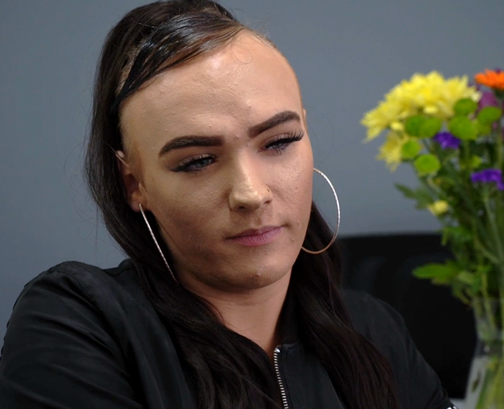
CONSULTATION & PARTICIPATION
“We’re all one massive big group, that needs our voice heard”
Tia-Louise
How do we encourage more young people, especially Care and Custody Leavers, to get involved in delivery?
Notes:
The film ‘In the Lead’ is an example of a participation project. In the film, Tia-Louise talks about the importance of young people having their voices heard. We are going to look at way of thinking about Participation that can help us to identify the different levels of involvement young people can have and how useful these are for them and for the organisation.

Slide 8
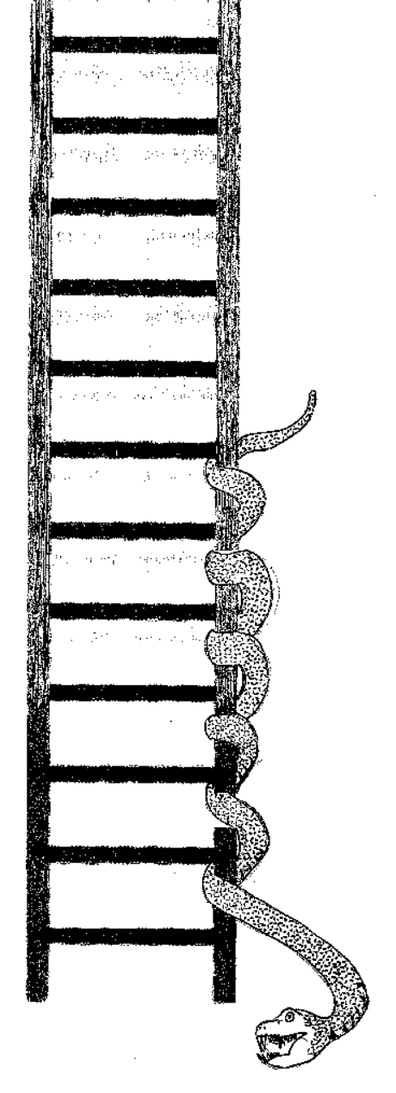
LADDER OF PARTICIPATION
Activity
In your groups add some examples to your ladder.
8. Young people initiated & directed
7. Young people initiated & decisions shared with adults
6. Worker initiated & shared decisions
5. Young people consulted & informed
4. Young people assigned & informed
3. Tokenism
2. Decoration
1. Manipulation
0. No involvement or engagement at all
Degree of Participation/Level of Engagement
Based on Harts ‘Ladder of Participation’,
resource designed by Sarah Hickie
Notes:
Introduce Hart’s Ladder of Participation
(The snake is our addition… to reflect that just as in the game of Snakes and Ladders, movement on the ladder can happen in both directions! Young people may engage for a time, make progress, and then drop out as other things are happening in their lives. This is normal. )
Hart identifies 8 levels of participation, from no involvement at all to young people initiating and directing projects.
In small groups we are going to look at the Participation Ladder and think of examples from our own experience of projects or activities which might characterise each level.
Give each small group a copy of the handout ‘Ladder of Participation – Group Activity’ and ask them to discuss and add their examples
Come back together and invite groups to share their examples. If you wish you can provide copies of the handout ‘Ladder of Participation Group Activity – Examples’ which gives an example for each stage, and talk through these to reinforce learning.

Slide 9
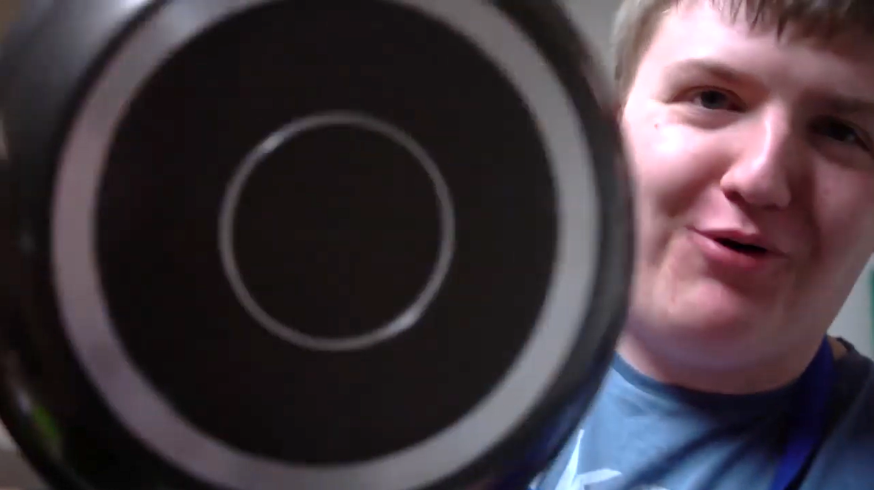
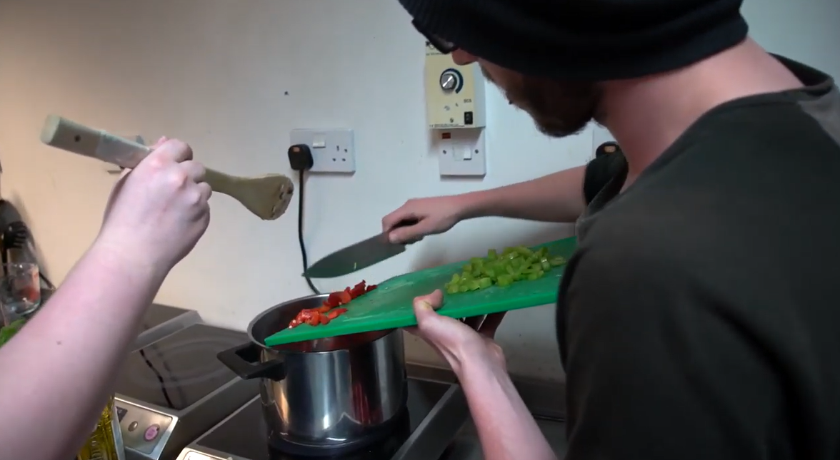
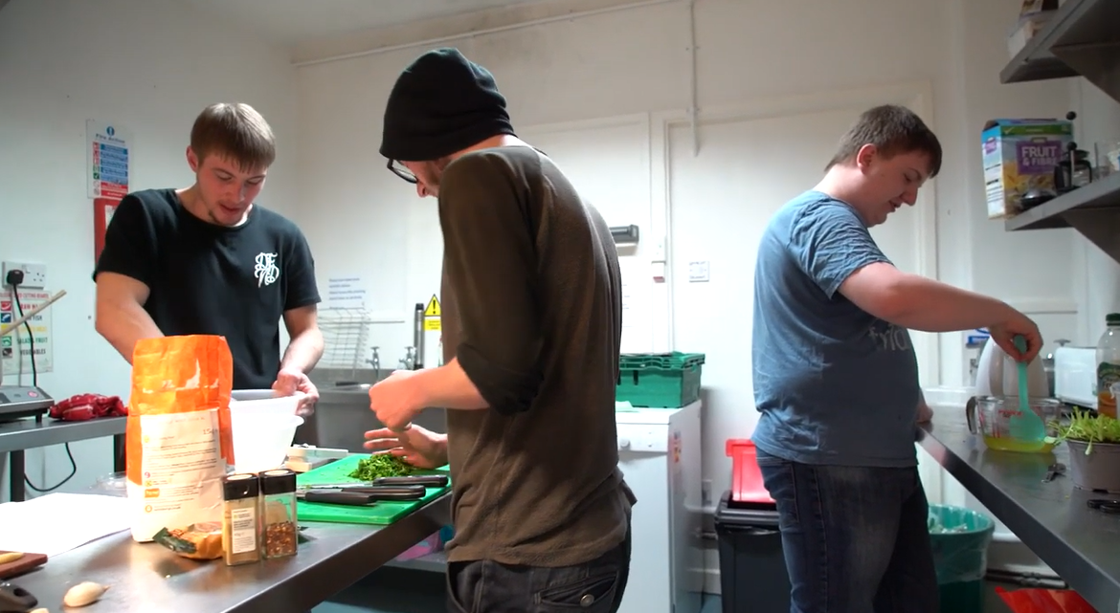
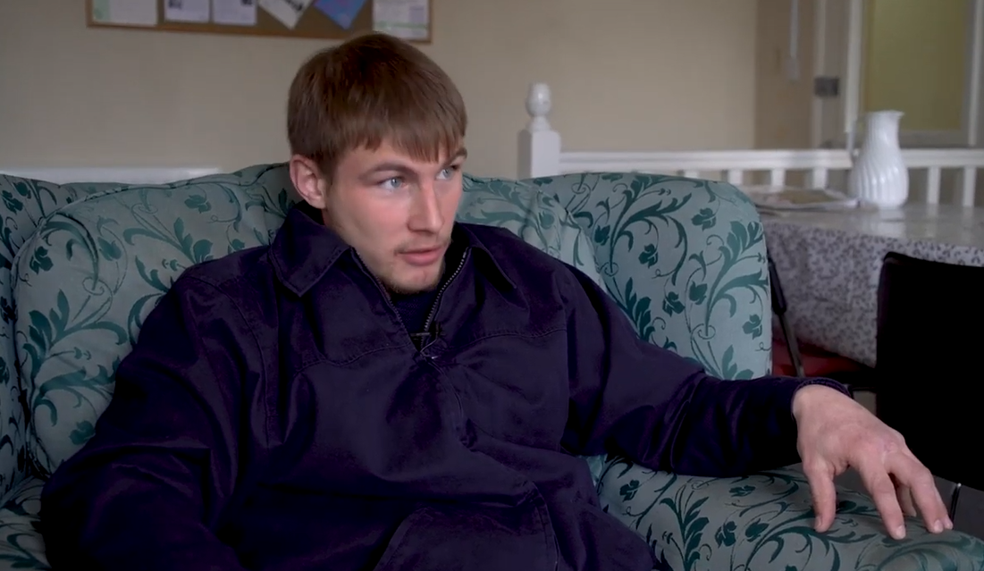
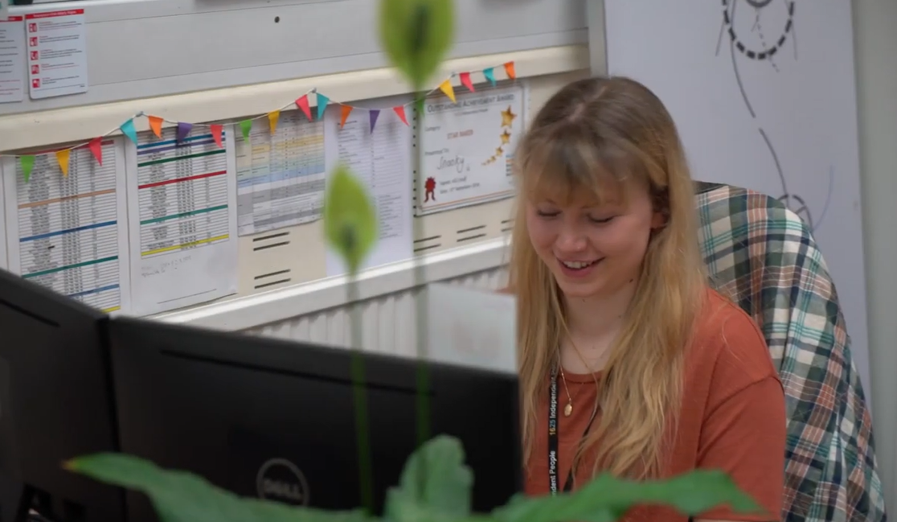
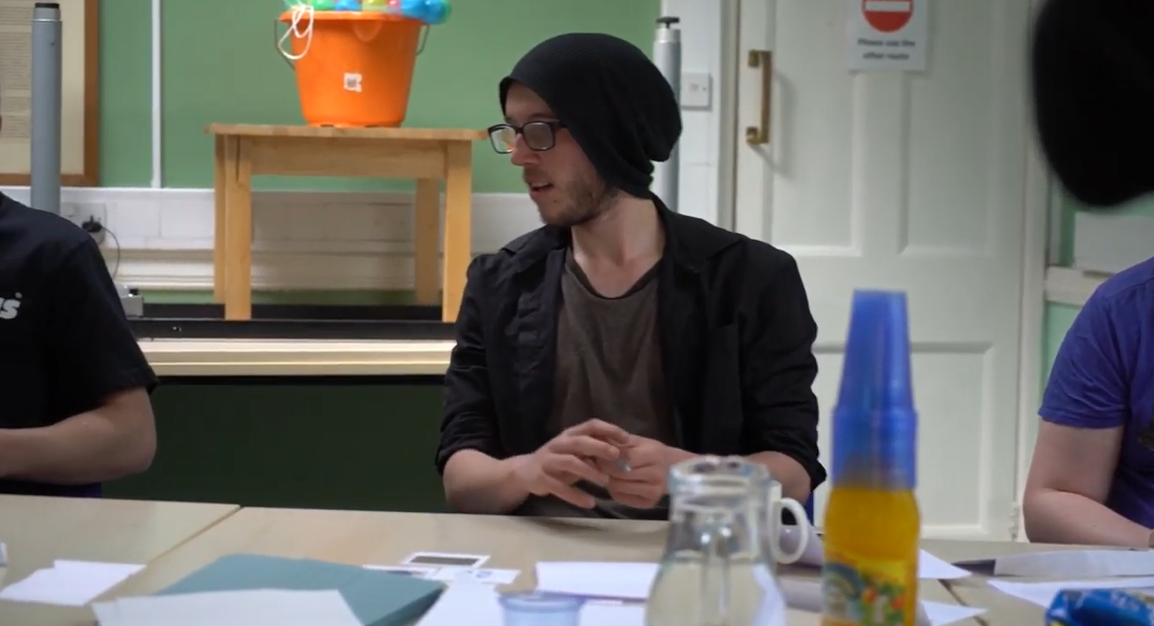
HOW WE DID IT
Notes:
The making of the film ‘In the Lead’ was a 12 week participation project we ran at 1625 Independent People. You might want to watch the film, available to download www.informingfutures.co.uk as part of this section.

Slide 10
HOW WE DID IT
Challenge
Young person is having a bad day & not in right frame of mind
Challenge
Young person’s idea isn’t achievable
Challenge
Young person disengages from project
Challenge
Young person becomes upset
Make them feel heard
Direct to support
Form a plan if they feel they can engage a bit later on
Make them feel heard
Work through other ideas
Manage expectations
Acknowledge reasons for disengagement
Keep checking in, but don’t push
Offer other ways to engage, e.g remotely
Thank them for their time and input
Acknowledge feelings, but in a tactful, generalised way
Use as a discussion point
Check in with them privately if needed
Remember, it’s ok to be upset!
Notes:
Participation work with young people can be challenging. We wanted to share some of the challenges we encountered on the ‘In the Lead’ project, to stimulate discussion about challenges you might face in your work. The slide offers a short summary, with the option to expand on this with the group activity outlined below.
In small groups:
Give out the handout ‘ Participation Challenges’. Invite each group to pick one to read, discuss and reflect on.
Invite groups to share their feedback.

Slide 11
HOW WE DID IT
Top Tips:
Build relationships and gain trust first
Have a plan, have a structure, use activities & visuals
Ask about interests, genuinely!
Keep initial contact regular
Just because someone is not in the room doesn’t mean they can’t participate, or be kept ‘in the loop’
Be mindful both of individuals, and the group
Don’t assume
Use incentives wisely, & don’t belittle intrinsic values
Don’t keep relying on the same young people
Give an out
Feedback outcomes!
Notes:
Talk through top tips from slide, expanding with more details and examples.
As the room if they have any further tips?

Slide 12
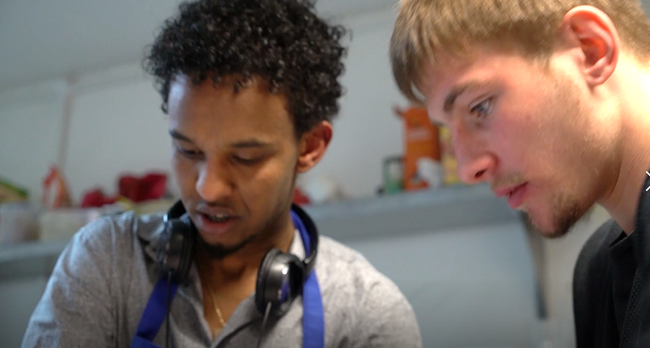
HOW WE DID IT
“They often speak the language of a teenager, or the area they came from, the people they hang around with. As a support worker you need to be able to adapt to that”
Kes
Notes:
This is a quote from a worker, speaking in the film ‘In the Lead’ .What are your thoughts about Kes’ advice?

Slide 13
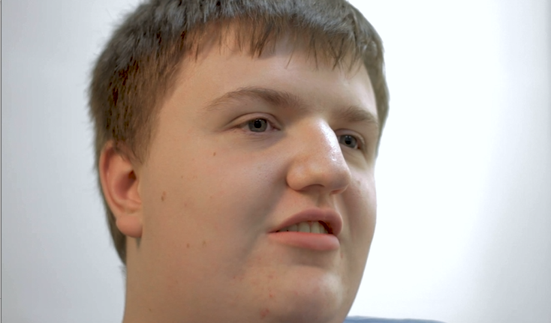
HOW WE DID IT
“We’re not pieces of paper, we are actual people”
Curtis
Notes:
End with this reminder from Curtis that whatever our agenda, young people should remain at the centre of all that we do.

Slide 14
FURTHER READING
Guidelines for Participation in Youth Work
http://www.youthworkessentials.org/volunteer-induction/involving-young-people-in-the-youth-group/guidelines-for-youth-participation.aspx
Beyond Youth Custody Participation Resources
http://www.beyondyouthcustody.net/tag/participatory-approaches/

Slide 15
QUESTIONS?
Thanks for listening
Copyright© 2020. Informing Futures is a 1625 Independent People project. 1625 Independent People is a charity and a registered society (Co-operative and Community Benefit Societies Act 2014, reg: 23964R exempt from registration with the Charity Commission). Registered office: Kingsley Hall, 59 Old Market Street, Bristol, BS2 0ER.
This resource was funded by The National Lottery Community Fund and is offered free for information, educational and professional development purposes • You may not sell this work, nor may it be used as supporting content for any commercial product or service • All copies of this work must clearly display the original copyright notice and Informing Futures website address • Any on-line reproduction must also provide a link to the Informing Futures website.

