Slide 1
YOUNG PEOPLE IN THE LEAD TRAINING
Modules available in this series:
Module 1: Facts About Care & Custody
Module 2: Trauma Informed Working
Module 3: Building Relationships
Module 4: Developing Independence
Module 5: Spaces & Places
Module 6: Boundaries
Module 7: Consultation & Participation
Module 8: Staff Wellbeing

Slide 2


MODULE 5
Spaces & Places
This resource is part of the Informing Futures toolkit www.informingfutures.co.uk It was co-created with young people, and reflects what they felt practitioners most needed to understand in order to work successfully with care and custody experienced young people.
For more information or queries on any of the topics covered in this toolkit, or to find out about training and consultancy we can offer please contact enquiries@1625ip.co.uk
Special thanks to all the young people who took part in YPIL directly or supported our research for these resources: Ahmed, Alexis, Ashraf, Curtis, Ethan, John, Michael, Nikita, Rowen, Tia-Louise, & Tyler-Jack
Copyright© 2020 Informing Futures is a 1625 Independent People project.
Copyright© 2020. Informing Futures, a 1625 Independent People project.

Slide 3
MODULE 5: SPACES & PLACES
Physical Environments
Exploring Impact
Our Influence
Notes:
Introduce the themes we will be exploring today:
Physical environments – we are all affected by the physical environment around us, but we don’t often stop to think about how different people can be experiencing different things in the same spaces
Exploring Impact – We’ll use a day in the life of a young person to think about the impact the physical environment can have on young people
Our Influence – We’ll finish by considering how we can positively influence the physical environments in which we do our work

Slide 4
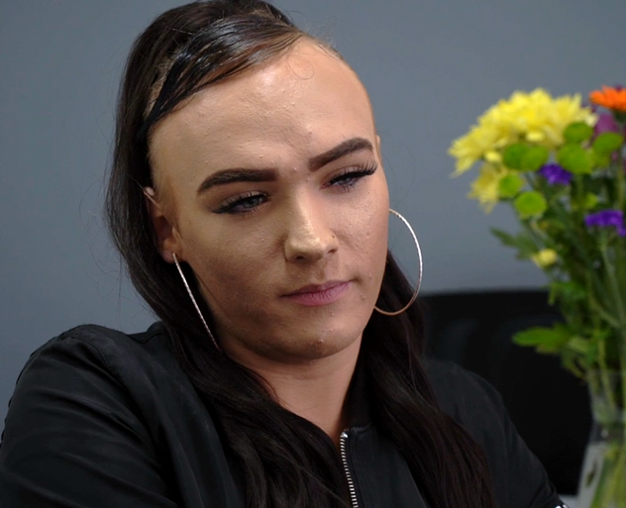
PLACES & SPACES
“Some young people go out with their support workers and basically just go for coffee, or tea”
Tia-Louise
Notes:
Why is Tia’s comment significant?
It can be easy to ignore or overlook the impact of the physical environment on our work. YP have told us that the fact we can meet them in a neutral place like a coffee shop is one of the things they really like about our support. Our choice of spaces and places in which to interact sends subtle messages to our service users, and can have a big impact on the effectiveness of our work.

Slide 5
PLACES & SPACES
We’re all affected by the environments we find ourselves in.
How can we be mindful of this when we work with young people?
Are you empowered to work with young people at places that suit both you and them?
Notes:
It is important to recognise that we all respond differently, and one space may not be able to meet all your service user’s needs.
To explore a bit more how young people might experience the physical environment in a very different way to adults, we’re going to put ourselves in the shoes of a young service user.

Slide 6
PLACES & SPACES
Let’s consider how the physical environment affects our work with young people by taking a journey to the Job Centre

Slide 7
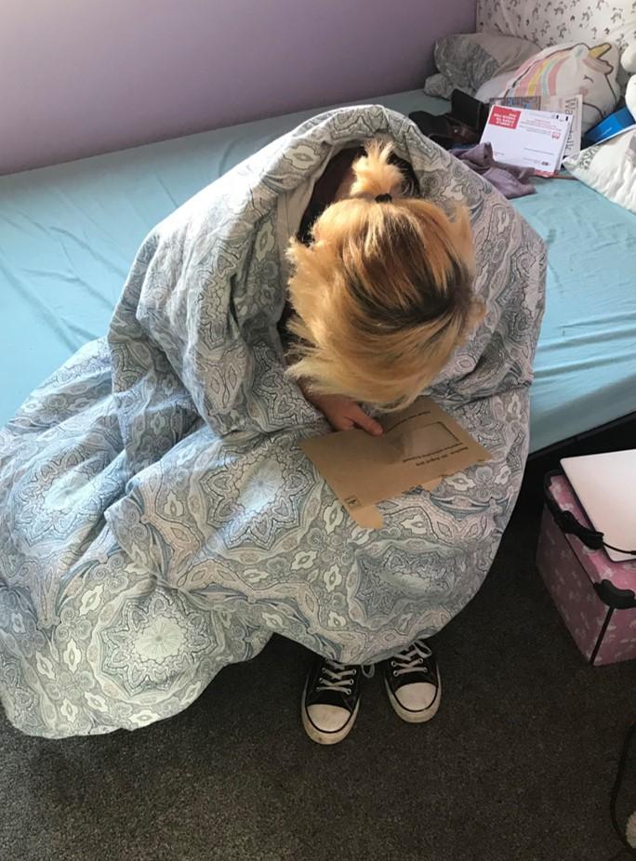
ALEXIS’ JOURNEY
Need to go to my Universal Credit appointment today…

Slide 8
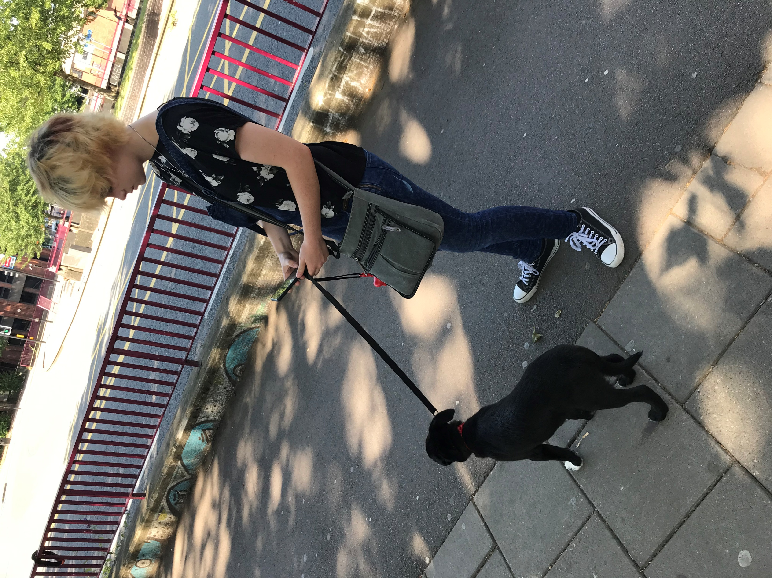
ALEXIS’ JOURNEY
How do I get to the jobcentre?

Slide 9
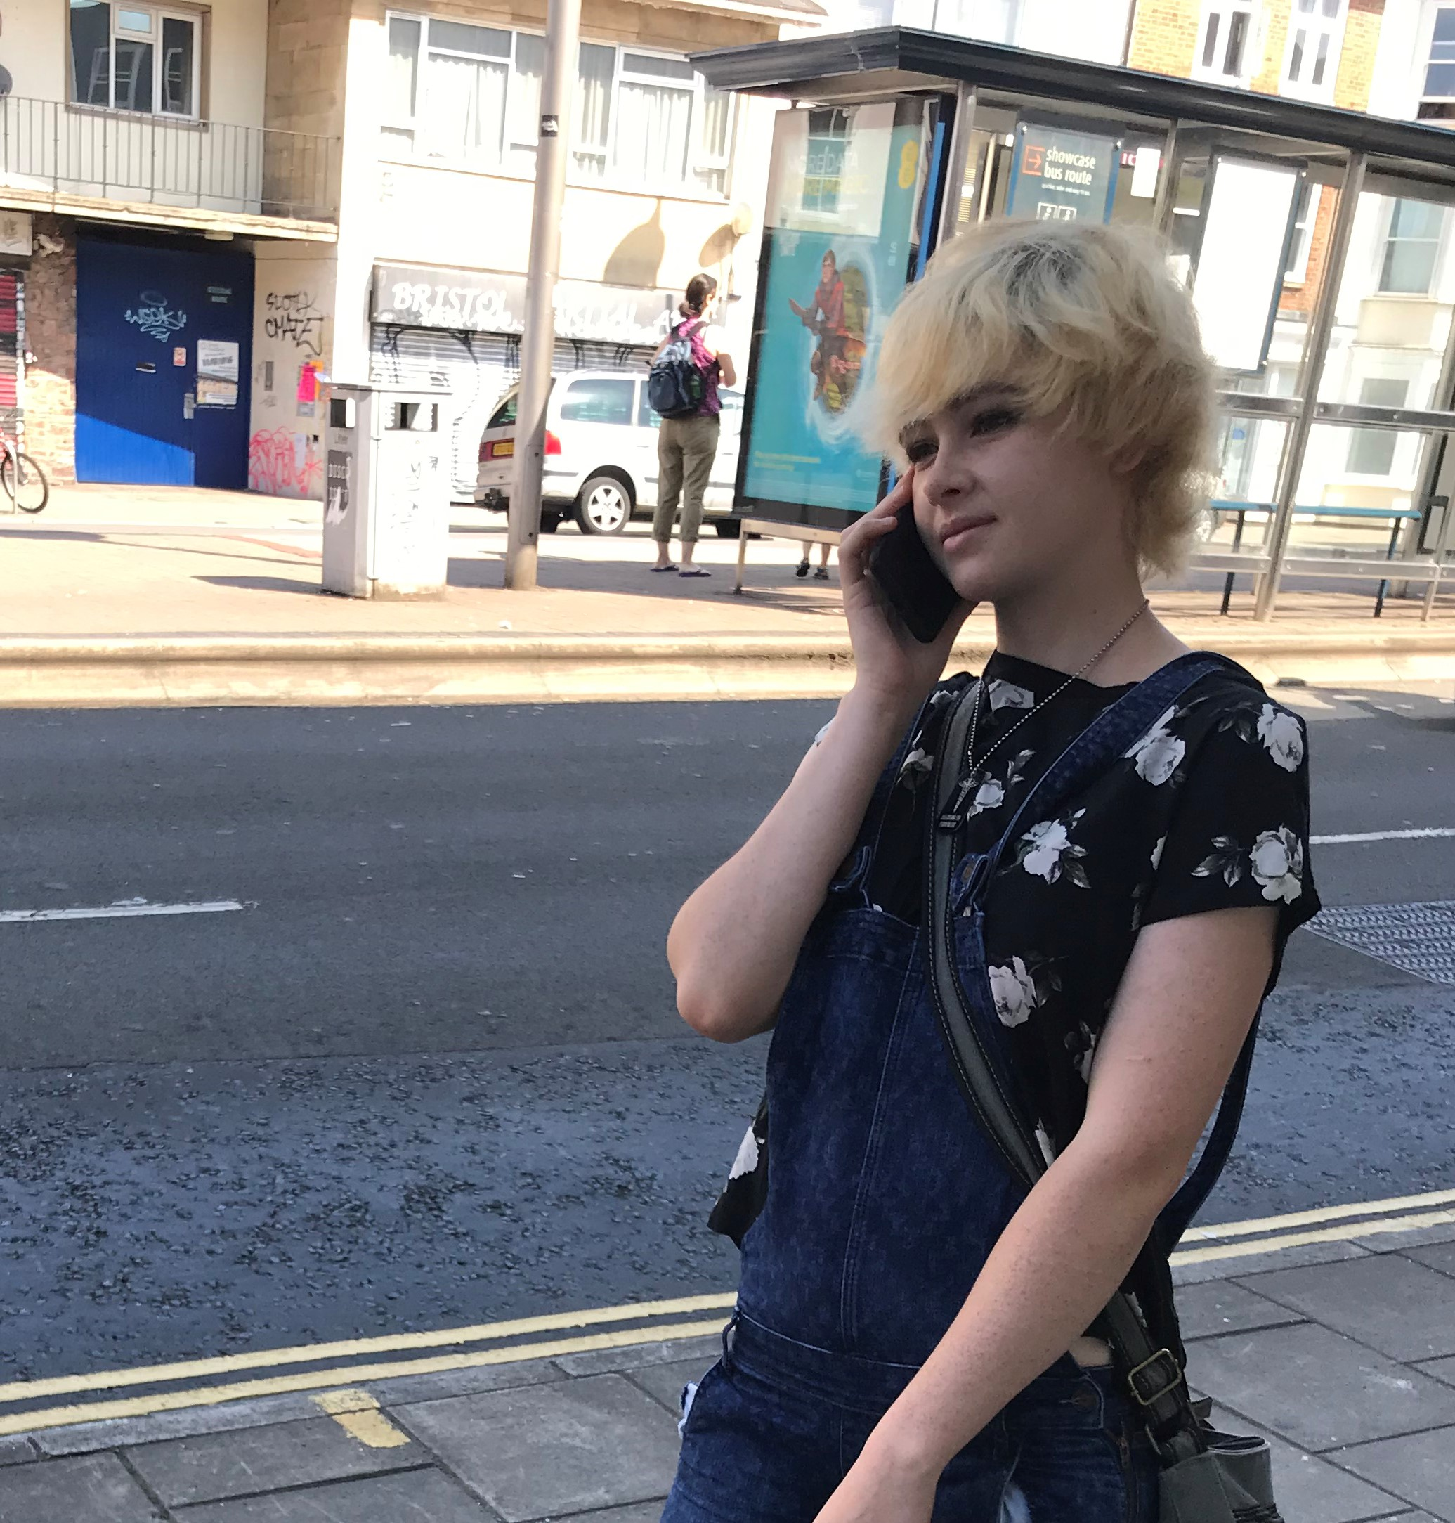
ALEXIS’ JOURNEY
Hi… any chance I can get a lift today?
Not today, I’m busy – sorry!

Slide 10
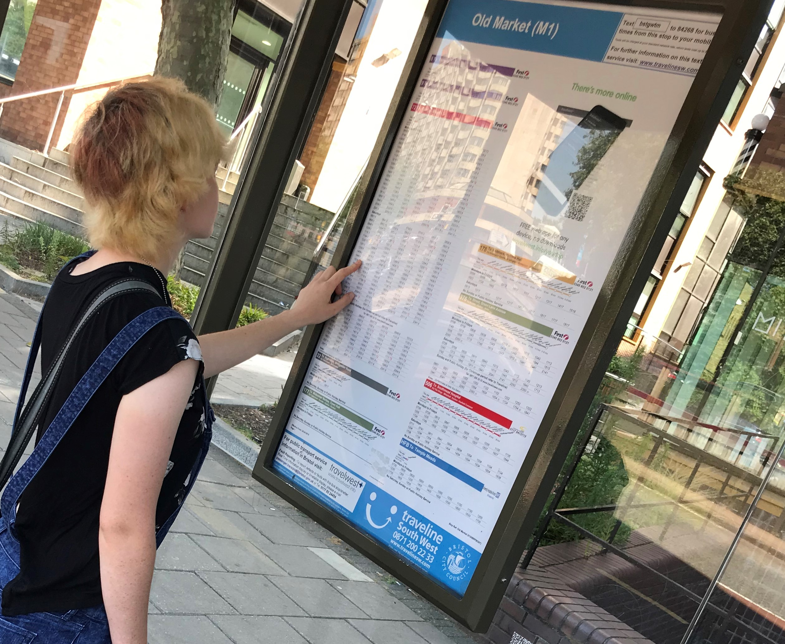
ALEXIS’ JOURNEY
How do I work out which
bus goes there?

Slide 11
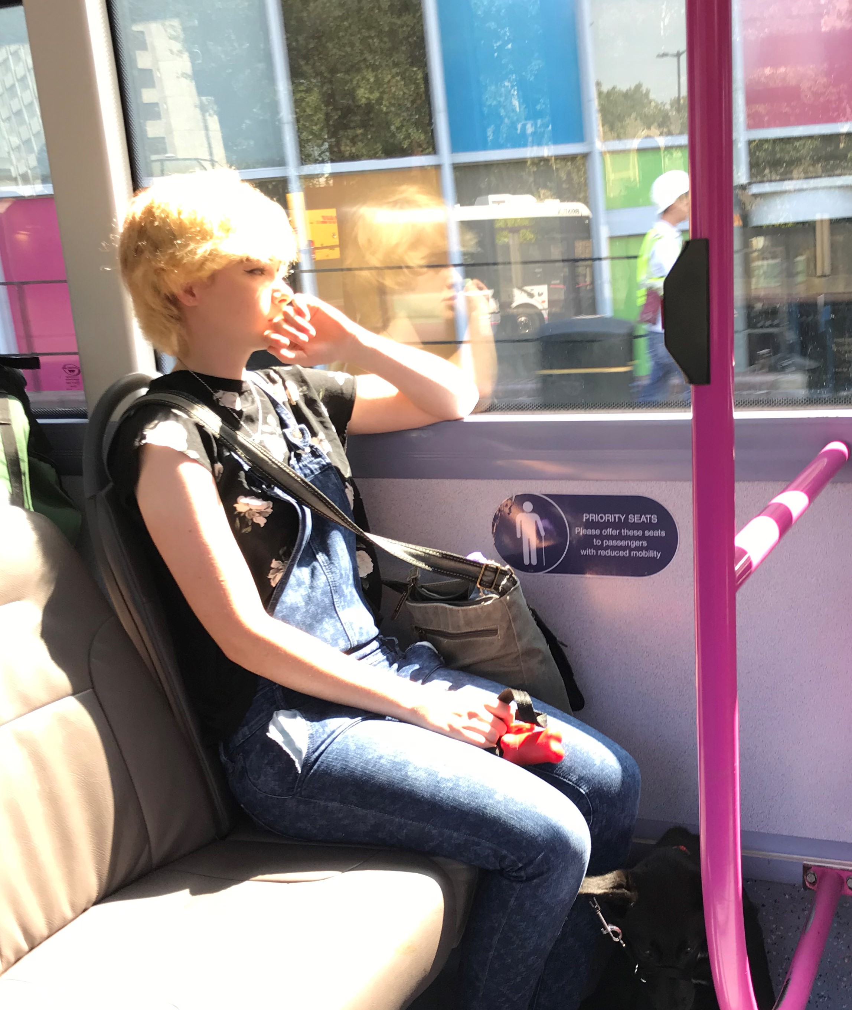
ALEXIS’ JOURNEY
What if I miss my stop?

Slide 12
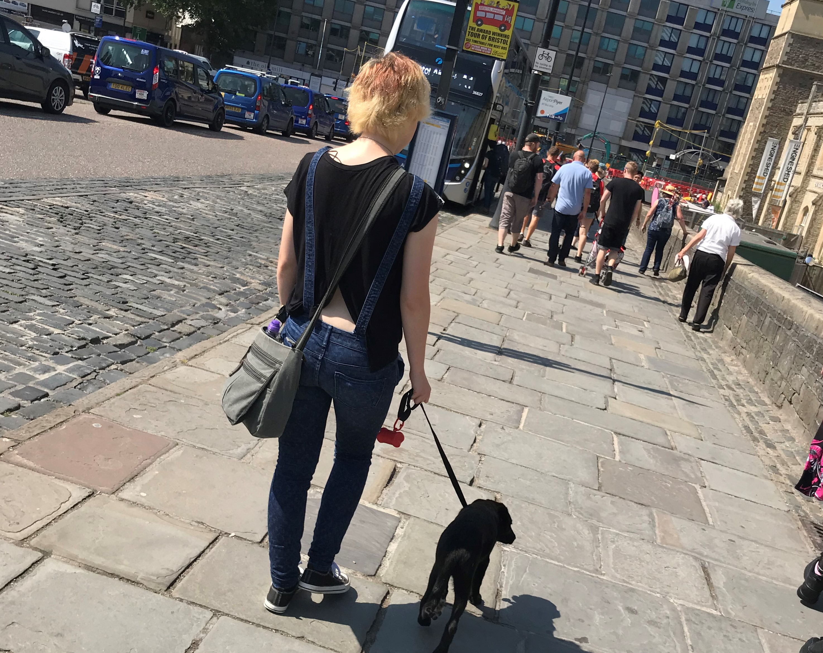
ALEXIS’ JOURNEY
Made it this far… now where is the jobcentre?

Slide 13
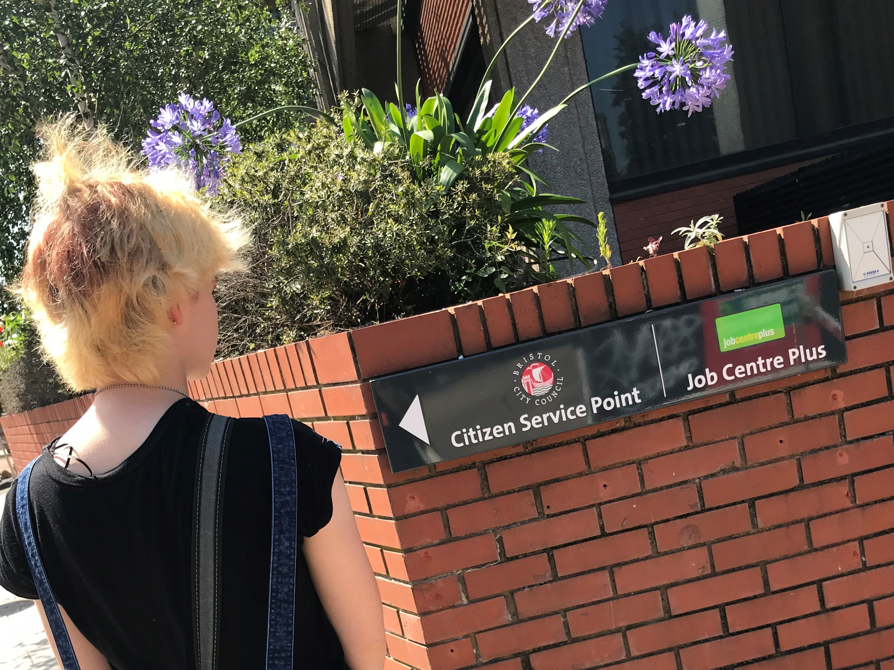
ALEXIS’ JOURNEY
I think this is it…?

Slide 14
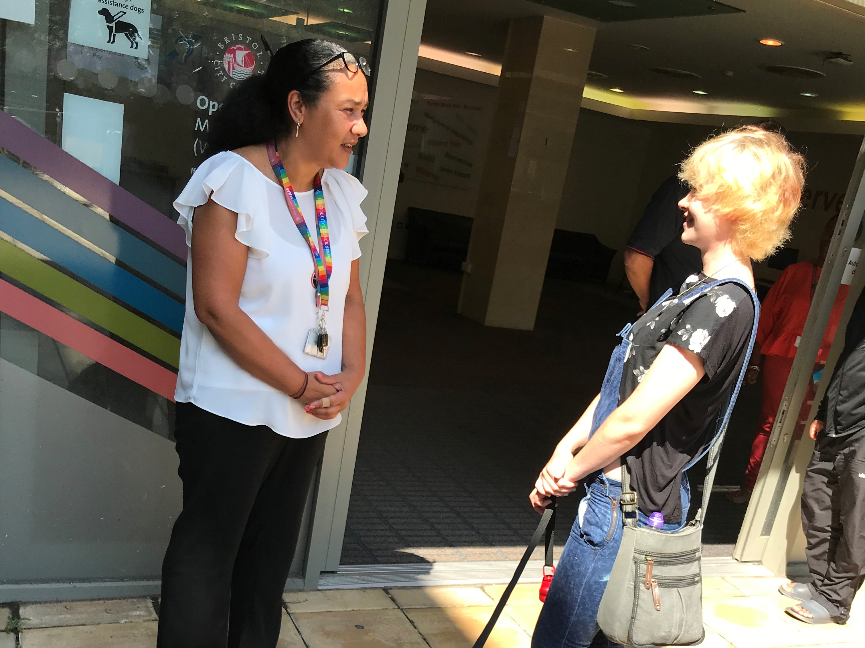
ALEXIS’ JOURNEY
Is this the right place?

Slide 15
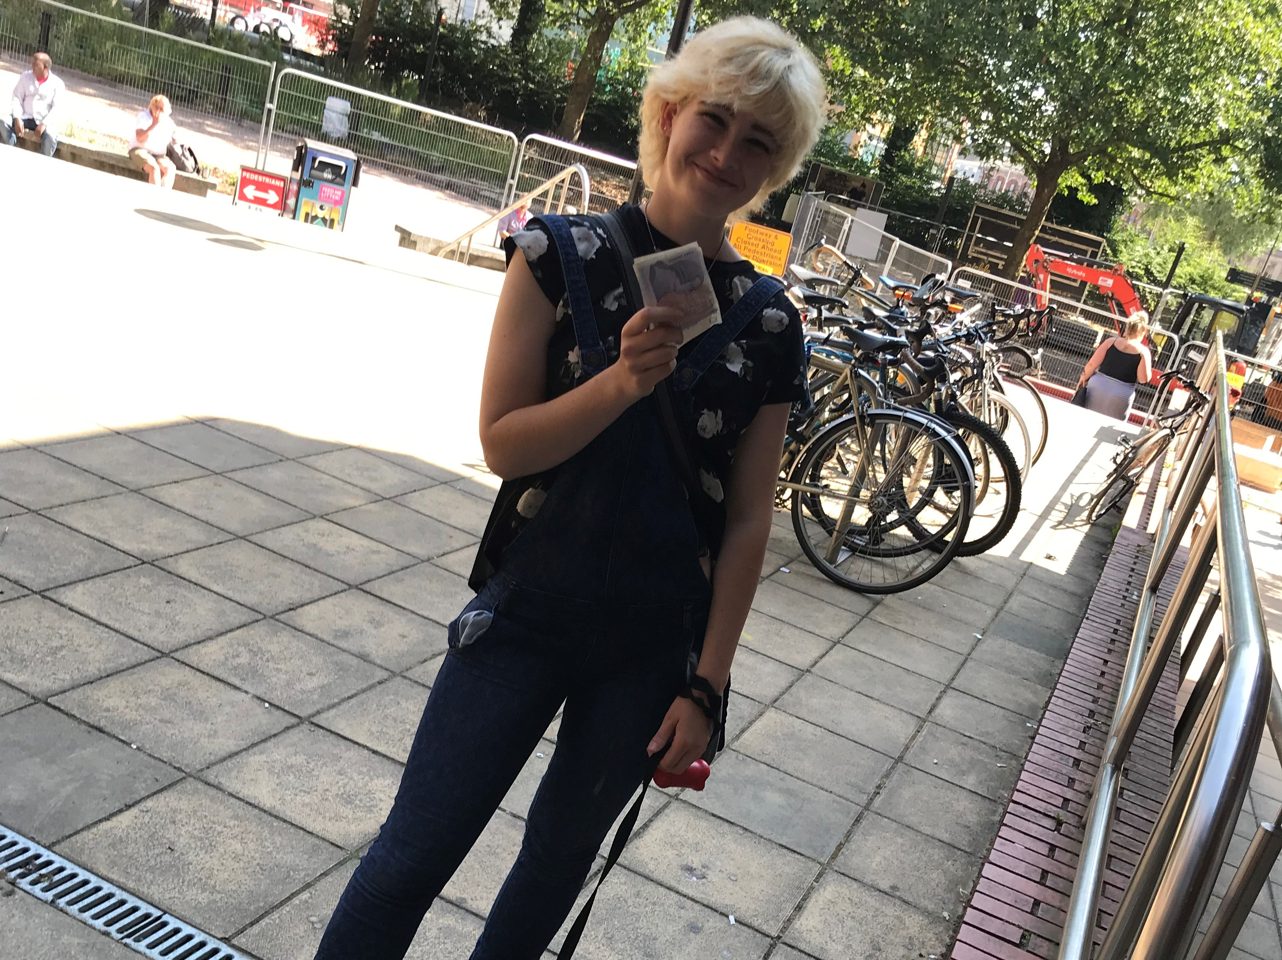
ALEXIS’ JOURNEY
I’m glad that’s over… now I just have to work out how to get home…

Slide 16

ALEXIS’ JOURNEY – EXERCISE
Let’s retrace Alexis’ steps and think more about the impact of the environment at each stage
In pairs or small groups, look again at the story frames you have been given
Consider:
What might Alexis be thinking or feeling?
What resources might they have to help them?
Do you have experience of similar situations in your own work with young people?
After discussion, we’ll share our learning by feeding back to the group
Notes:
Ensure each pair or small group has a copy of the Photo Story handout that they can see and make notes on.
If you have a large group, consider asking each small group to take one or two slides each to discuss, to make the most effective use of the time. How long you spend on this will depend on how big and how vocal your group is – but allow enough time for people to have considered the discussion points above.

Slide 17
PLACES & SPACES
We are all affected by the physical environment around us
Navigating this environment is something we learn to do through experience and knowledge
The right guidance at the right time can change our experience

Slide 18
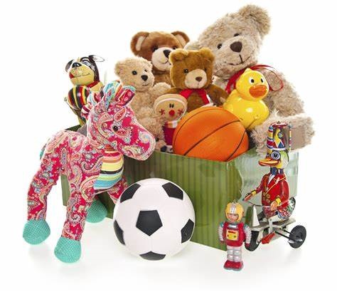



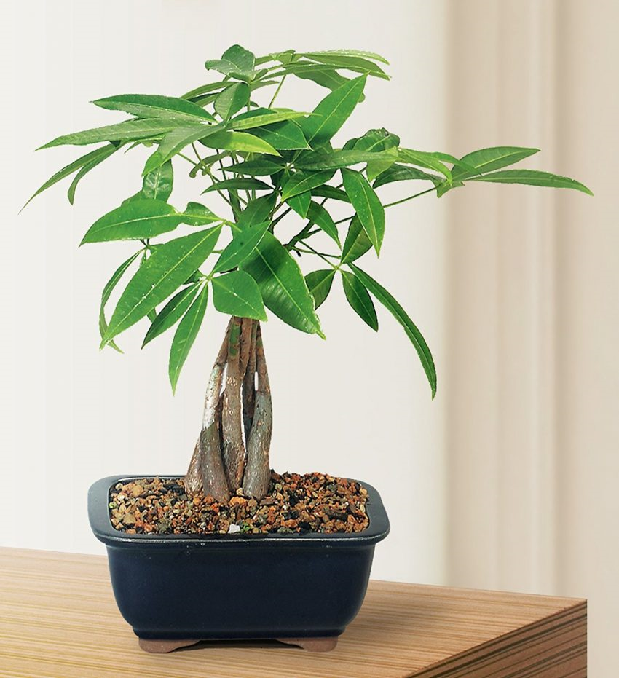
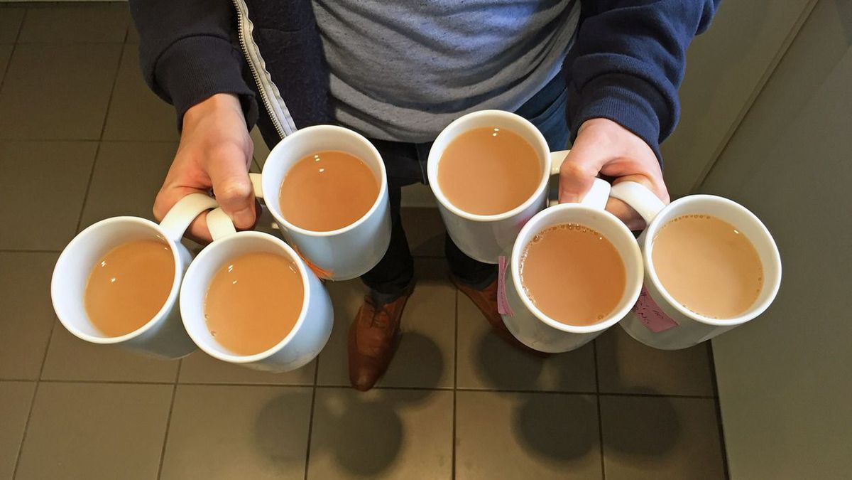
PLACES & SPACES
There is always something we can do to influence our physical environment
Notes:
Encourage discussion about what simple things can be done to influence working environments – these measures do not always have to be costly or complicated to provide.
Consider the messages our spaces are sending about our services. What does an untidy office or reception say?
Just ensuring the existing spaces are clean and tidy can make a big difference to how it feels being in them
Improving the environment for staff often directly improves the service for service users – discuss where and how staff and service user wellbeing might overlap with regard to the physical environment
Waiting areas – in services where it is common for service users to need to wait, particular attention can be paid to waiting areas as these can be places which provoke a lot of anxiety

Slide 19
PLACES & SPACES
Take Away
What 2 actions can you commit to today which will have a positive impact on your working environment?
Will these improve the environment for staff, service users, or both?
Notes:
Encourage participants to add their commitments to their notes to remind them of the actions they want to take
Actions can be shared in the room if this feels appropriate (can spark ideas for those who might be struggling to think of anything)

Slide 20
PLACES & SPACES
“Do what you can, with what you have, where you are.”
Theodore Roosevelt
Notes:
We end with this thought in recognition of the fact that many of us work in challenging situations, and may sometimes feel that we can’t always do everything we would like to for our service users.
It can be helpful to remember that making the small changes we CAN make, can lead us closer to the large changes we feel are out of reach.

Slide 21
THANK YOU
We’d like to thank:
Our models, Alexis and Athena, for helping us to tell the story
Nicole Anderson for photography and direction
The Temple Street Jobcentre staff for their kind cooperation

Slide 22
QUESTIONS?
Thanks for listening
Copyright© 2020. Informing Futures is a 1625 Independent People project. 1625 Independent People is a charity and a registered society (Co-operative and Community Benefit Societies Act 2014, reg: 23964R exempt from registration with the Charity Commission). Registered office: Kingsley Hall, 59 Old Market Street, Bristol, BS2 0ER.
This resource was funded by The National Lottery Community Fund and is offered free for information, educational and professional development purposes • You may not sell this work, nor may it be used as supporting content for any commercial product or service • All copies of this work must clearly display the original copyright notice and Informing Futures website address • Any on-line reproduction must also provide a link to the Informing Futures website.

