Slide 1
YOUNG PEOPLE IN THE LEAD TRAINING
Modules available in this series:
Module 1: Facts About Care & Custody
Module 2: Trauma Informed Working
Module 3: Building Relationships
Module 4: Developing Independence
Module 5: Spaces & Places
Module 6: Boundaries
Module 7: Consultation & Participation
Module 8: Staff Wellbeing

Slide 2


MODULE 4
Developing Independence
This resource is part of the Informing Futures toolkit www.informingfutures.co.uk It was co-created with young people, and reflects what they felt practitioners most needed to understand in order to work successfully with care and custody experienced young people.
For more information or queries on any of the topics covered in this toolkit, or to find out about training and consultancy we can offer please contact enquiries@1625ip.co.uk
Special thanks to all the young people who took part in YPIL directly or supported our research for these resources: Ahmed, Alexis, Ashraf, Curtis, Ethan, John, Michael, Nikita, Rowen, Tia-Louise, & Tyler-Jack
Copyright© 2020 Informing Futures is a 1625 Independent People project.
Copyright© 2020. Informing Futures, a 1625 Independent People project.

Slide 3
MODULE 4: DEVELOPING INDEPENDENCE, SESSION CONTENT
Empowerment vs disempowerment
The journey to independence
How identity plays a part
How we as professionals fit in
Notes:
Introduce topic and what we will be covering today:
Who are we talking about?
Why do young people go into care or custody?
Where do we come in? A bit about what we as practitioners, as well as society at large, can contribute, as well as introducing two government led pieces of work on this topic.

Slide 4
WHAT IS INDEPENDENCE
not subject to control by others
not requiring or relying on something else
not looking to others for one's opinions or for guidance in conduct
not requiring or relying on others (as for care or livelihood)
showing a desire for freedom
Notes:
Ask your group to tell you what they think is meant by independence. You can record their answers on a flipchart if that is helpful.
We talk a lot about promoting independence, and it is almost always assumed to be a positive thing for young people. But independence is a complex and nuanced subject, and in reality different levels of independence are appropriate for different individuals at different times
Reveal the defintions and discuss with the group:
Are these really what we want for young people?
Where do we agree/disagree ?
What might be better?

Slide 5
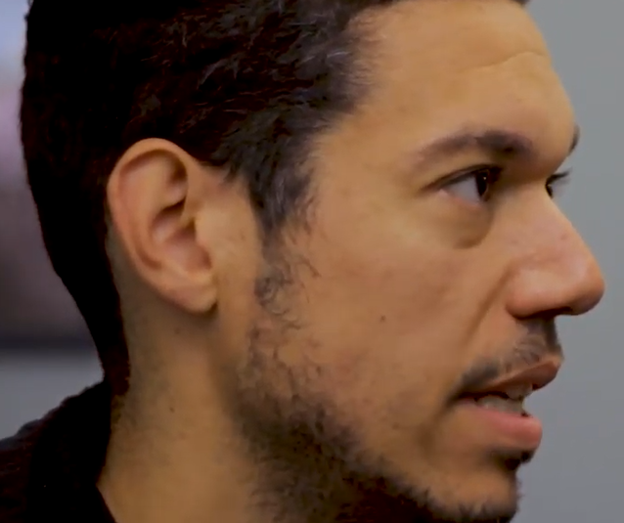
WHAT IS INDEPENDENCE ?
“As much as I can I would try to let the Young Person lead”
Seb
Notes:
This is Seb – an intensive support team leader with 1625 Independent People, and this is a quote from the film made by Future 4 Me young people. (You can see the full version on the Informing Futures Toolkit website).
We want to encourage young people to have a safe level of control within their lives - to be able to take the lead when they want to, or need to.

Slide 6

WHAT IS EMPOWERMENT? – EXERCISE
having the knowledge, confidence, means, or ability to do things or make decisions for oneself
Exercise – 5 minutes in pairs:
Person 1: Talks about a time where you have felt empowered/disempowered.
Person 2: Note any key themes, situations or behaviours of people involved that stand out.
Share your notes and consider the question – what could have been changed to make a disempowering situation empowering? (or vice versa)
Then swap round so everyone gets a go!
We’ll come back together to discuss.
Notes:
It may be more helpful to think about the concept of empowerment than independence. Empowerment involves the ability to do things for oneself – but does not imply that we don’t also need other people.
In your pairs, compare notes about times when you have felt empowered or disempowered. Choose examples you feel comfortable to share – the point of the exercise is to recognise the feelings, behaviours and situations which characterise empowerment and disempowerment

Slide 7
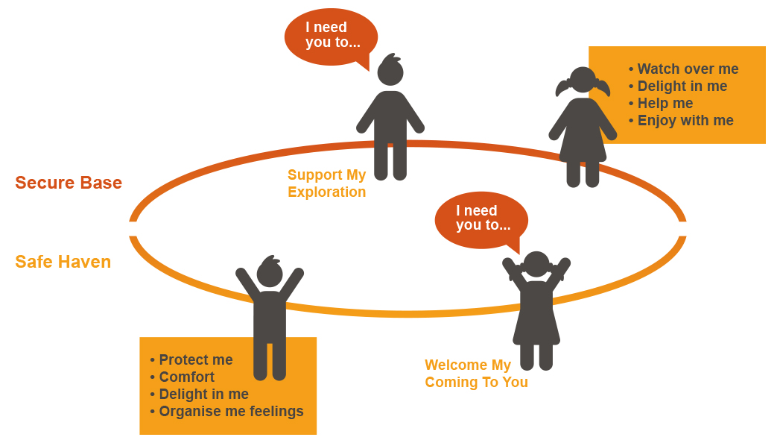
BUILDING BLOCKS - SECURITY
Cooper, Hoffman and Powell www.circleofsecurity.net 2009
Notes:
Let’s consider the building blocks which are needed to develop empowerment and appropriate independence in young people.
The circle of security
Cooper, Hoffman and Powells model illustrates how from our very early years, we begin to experiment with independence. Young children will venture out from a secure base to explore, and then return to express and share their experience. The way in which their parent or carer supports this will either –
encourage them gradually to widen their area of exploration (secure attachment) OR
discourage them, provoking feelings of fear and anxiety (insecure attachment)
Cooper, Hoffman & Powell’s research suggests that secure children exhibit increased empathy, greater self-esteem, better relationships with parents and peers, enhanced school readiness, and an increased capacity to handle emotions more effectively when compared with children who are not secure.
For those whose circle, and attachment with a caregiver, was disturbed in childhood (which is more likely for those young people who have been placed in care or who go on to offend as young people), ability to develop skills and attributes needed to be independent could be impaired.
The circle of security is also a nice way to frame how we think about independence, ultimately we all need a safe base and somewhere to be able to go back to for support, in order to feel confident and capable to venture out on our own and try new things out for ourselves.
Question for the group –
Can our support offer this model of a ‘secure base/safe haven’ to young people who have not experienced it in childhood? How?

Slide 8
BUILDING BLOCKS - IDENTITY
‘Benefit scroungers’
Dependent
Immature
Client
NEET
Lazy
Mentally ill
Disabled
Perpetrator
Challenging
Offender
Reliant
Anxious
Victim
Service User
Notes:
The way we identify ourselves can affect how independent and empowered we are able to feel. Young people, like many groups in society, are often spoken about in negative terms in the media. Young people who experience homelessness, care, or are involved in the criminal justice system face even greater stereotyping and prejudice. Event the support services which exist to help people can fall into the trap of using language or approaches which diminish people and label them as dependent.
In pairs of small groups
Looking at the words on the slide, discuss:
What terms do we use which might give young people the feeling they are dependent on us?
What language do young people use about themselves which might be limiting or negative
How can we challenge negative and limiting language and promote positive and empowering language?

Slide 9
FEELING INDEPENDENT – CASE STUDY
Regularly going to college
Leaving foster placement
Moving into new flat
Drops out
of college
Calls mental health services
First appointment
Regular appointments
Starts at new college
Secure base
Travelling alone
Feeling good
Loss of Choice
Anxiety
Not ready
More Control
Building Identity
Making Choices
Exercising Choice & Control
BUT
Unable to cope emotionally with the consequences
Seeking Advice
Acting on it
Feeling vulnerable
Needing support
New routine
Building confidence
More control
Making Choices
Enjoying Positive Consequences
Notes:
This exercise is for the group. The journey is based on a real young person. We’re going to look at how independence feels from a young person’s point of view, versus how it looks to adults.
Reveal the headings one at a time, and ask the group to discuss or vote on whether the event increases or decreases the young person’s sense of independence. Then reveal the arrow which indicates the young person’s opinion of how their independence was affected. The detailed notes below provide background information which you can share after the arrow is revealed.
Regularly going to college – This young person has initially been on quite steep trajectory of independence. They’ve been living with their foster carers in a placement, which they really enjoy. The foster carers have provided a stable base for the young person and encouraged them to begin to do more things for themselves, sometimes outside of their comfort zone. The young person is relatively settled, they’re feeling good and they are engaging well with college, regularly going in on the bus on their own.
Leaving foster placement – When the young person is 17 and a half conversations begin about their impending move on from their foster placement. They feel pretty upset and worried about this, and although they have been showing amazing progress towards independence they still feel like they need the support of reliable adults. Most of their friends at college aren’t expected to be as independent as they will have to be when the move on and are given their own flat. This starts to feel frustrating, and the young person begins to ‘need’ their foster carers more, asking for and then demanding lifts to college (which the foster carers initially refuse as they are worried about the young person ‘going backwards’, but they don’t really explain their reasons, and regularly give in to the young person’s demands). Sometimes they young person doesn’t make it into college. Their social worker is contacted and becomes worried, and starts to message the young person each morning to remind them to go in, the young person resents ‘not being trusted’.
Understandably when it comes time to move into their new flat the young person requires some practical support to do so, as we all would, – and their foster carers offer to help. However the young person becomes frustrated that they can’t drive yet, and help to move their things feels like another blow. The young person starts to feel less independent over-all.
What could have helped the young person view needing practical support to move more positively?
Moving into new flat – Once in the new flat things start to look up a bit. The young person loves being able to make an entire flat feel like theirs, and enjoys beginning to decorate with their belongings. They also enjoy chatting through with their new support worker what they need for the flat, and making lists, the support worker is impressed with their rapid progress. The young person goes off shopping on their own a few times to spend some of their leaving care grant on items for their kitchen, and buys a couple of recipe books. They feel the most independent they have for a while, and they’re back to getting the bus to college most days on their own. Their new support worker doesn’t remind them to go, but does ask how it is going when they catch up.
Drops out of college – Whilst the young person was initially happy in their new flat, despite their worries before moving in, they begin to feel a bit lonely there. At their foster placement they lived with their two foster carers, as well two of their children and the family dog. They meet up with their foster carers every now and again, but they are thinking of moving. Things also start to go less well at college, the young person had been making the most of being able to stay up late playing music whenever they want, something their foster carers wouldn’t let them do. They begin sleeping through their alarms, and start to feel less motivated. The college try to tackle the young person’s poor attendance, and their social worker also tries to talk to the young person about this, but the young person feels they are interfering. They initially don’t see the point in going in every day, as they feel they can do their work fine at home, even if it means staying up late, but when they fail a module they become quite depressed. Ultimately they choose to completely drop out of college, and refuse to engage in any conversations with either college or their workers about other options. At first this felt like a relief, but then they feel even more awful.
We’ve marked the young person as being less independent as a result of dropping out of college, but was the young person exercising their independence by making a decision on their own?
Calls mental health services – The young persons social worker has been trying to reach the young person, calling them and dropping by, but they don’t answer the phone or the door. However, after a few weeks the young person makes a decision themselves to call up local mental health services, after talking with a friend and looking them up online. The mental health services agree with the young person’s assessment that they need some additional support, and they schedule an initial assessment for a few weeks time.
First appointment – The young person still hasn’t spoken much with their social worker, apart from a few chats when they realise their worker is really worried about them and answer the door. However, despite saying they felt ok to get the bus to the appointment the night before they ring their worker and ask for a lift. When they arrive they ask the worker to also come into the appointment. To the young person this feels like a dip in independence, as the young person didn’t feel up to attending independently and felt less independent for ‘needing services’ and needing their worker to go into the appointment.
Can the feelings about a young person’s level of independence differ, can workers observations of a young person be different to how they feel?
Regular appointments – Despite feeling nervous, and finding their first appointment hard, bit by bit the young person and the support worker work towards the young person attending independently on their own. They are now in a routine, get the bus every two weeks and are starting to feel much better. As they are doing 1to1 CBT they begin to identify how their feelings, thoughts and behaviours interact and steps they can take to feel more in control of their feelings, thoughts and or behaviours. The mental health professional also helps them to recognise that their strengths, and how far they’ve come. They also work together to identify some interests the young person has, and come up with some ideas of things to do.
- How does feeling in control (or not!) affect how independent we feel?
Starts at a new college – this time the young person makes a choice and experiences positive consequences – they like the college and the course they have chosen, start to make new friends and feel positive and empowered to move towards new goals.
Question for reflection – Do we assume young people are experiencing more independence as a good thing, or do we talk with them about how things feel as their journey progresses?
If you wish, you can distribute the handout (which contains the notes above) for participants to keep after the exercise

Slide 10
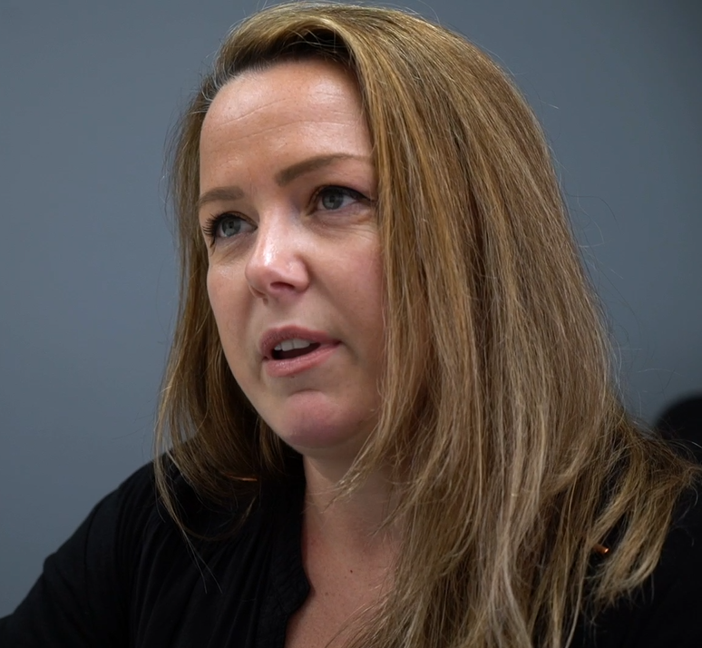
BUILDING INDEPENDENCE HEALTHILY
As practitioners we can:
Recognise independence is a journey, and looks different for different people
Ask what ‘independence’ young people want
Meet young people where they are at
Provide choices
Spot and praise progress
Be a secure base and a safe haven
Use language which promotes empowerment
‘I help young people recognise their strengths, and successes’ - Luci
Notes:
Independence is both a journey, and something that can look and feel quite different from person to person. However, being able to be, and feeling, relatively independent is beneficial to individuals. Feeling and being relatively independent is more empowering than feeling reliant on others to always meet your needs, or support you to meet them. This said we all need the support of others sometimes, and, actually, identifying what support we need and benefit from, and recognising how appropriate relationships with others can help us meet our needs, is part of being independent.
We as workers will all have different working relationships with the young people we work with. This can impact to what extent we may offer ‘support’ vs expecting a young person to demonstrate independence.
Take a moment to talk to the person next to you about what your role is, and how much your organisation/your role/you personally require young people to be independent?
A practitioner supervising a young person in a new role, as a member of their team, may expect a level of independence relevant to the role.
Workers working with young people on improving their mental health may encourage self reflection on the topic of independence and explore how the young person could feel more in control, or develop positive independent behaviours.
A practitioner working for an advocacy service may be required to speak up for a young person on their behalf.
Workers in a crisis service may not expect young people to be particularly independent when they meet them, and recognise they may need a lot of practical and emotional support initially.
Ultimately though we can all play a part in supporting the young people we work with to develop appropriate independence and empowerment
As practitioners we can:
- Recognise independence is a journey, and looks different for different people
- Encourage self reflection
Meet young people where they are at
Provide choices
Provide opportunities to practice or be more independent
Spot and praise progress
Be there when things go wrong, or when we’re really needed
Empower young people!
It’s worth also asking young people you are going to be working with for a while what independence looks, or would look like, to them. In what ways do they already feel independent? What are their independence goals?

Slide 11
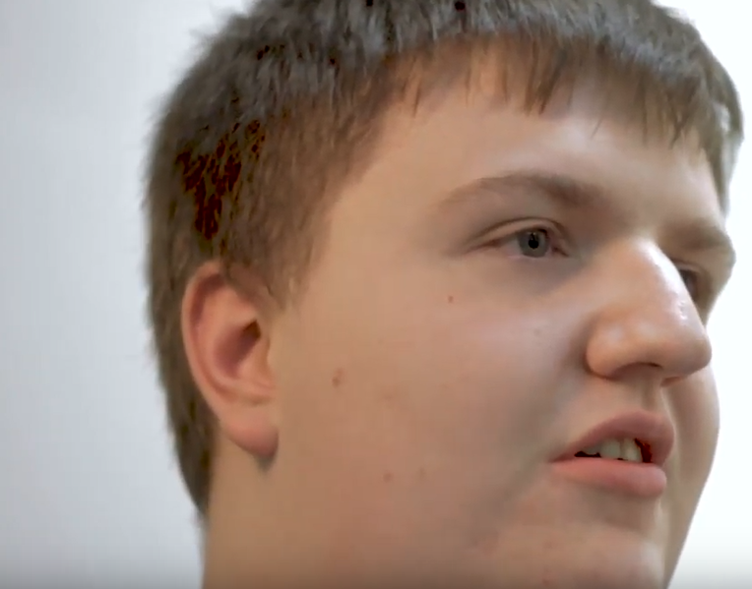
BUILDING INDEPENDENCE HEALTHILY
“It’s like you’re sort of in a bubble, but you’re still getting the freedom, not being smothered… you can still do whatever you want but if you need it, there it is”
Curtis
Notes:
This is Curtis, a young person who appears in the film In the Lead (You can watch the full version on the Informing Futures Toolkit website)
Curtis is describing in his own words what good support is like – and this is also a good summary of what healthy independence looks like – a balance between freedom and security.

Slide 12
QUESTIONS?
Thanks for listening
Copyright© 2020. Informing Futures is a 1625 Independent People project. 1625 Independent People is a charity and a registered society (Co-operative and Community Benefit Societies Act 2014, reg: 23964R exempt from registration with the Charity Commission). Registered office: Kingsley Hall, 59 Old Market Street, Bristol, BS2 0ER.
This resource was funded by The National Lottery Community Fund and is offered free for information, educational and professional development purposes • You may not sell this work, nor may it be used as supporting content for any commercial product or service • All copies of this work must clearly display the original copyright notice and Informing Futures website address • Any on-line reproduction must also provide a link to the Informing Futures website.

