Slide 1
YOUNG PEOPLE IN THE LEAD TRAINING
Modules available in this series:
Module 1: Facts About Care & Custody
Module 2: Trauma Informed Working
Module 3: Building Relationships
Module 4: Developing Independence
Module 5: Spaces & Places
Module 6: Boundaries
Module 7: Consultation & Participation
Module 8: Staff Wellbeing
Notes:
Relationships are recognised as the principle tool for change. In this module we will explore and discuss a few things that can affect our ability to build positive relationships, as well as provide some tips for this. Please note other modules particularly relevant to building relationships are developing independence, spaces and places, and working with boundaries.

Slide 2


MODULE 3
Building Relationships
This resource is part of the Informing Futures toolkit www.informingfutures.co.uk It was co-created with young people, and reflects what they felt practitioners most needed to understand in order to work successfully with care and custody experienced young people.
For more information or queries on any of the topics covered in this toolkit, or to find out about training and consultancy we can offer please contact enquiries@1625ip.co.uk
Special thanks to all the young people who took part in YPIL directly or supported our research for these resources: Ahmed, Alexis, Ashraf, Curtis, Ethan, John, Michael, Nikita, Rowen, Tia-Louise, & Tyler-Jack
Copyright© 2020 Informing Futures is a 1625 Independent People project.
Copyright© 2020. Informing Futures, a 1625 Independent People project.

Slide 3
OUR SESSION TODAY
Building Trust
Seeing the Good
Working with Values
Notes:
Introduce the topics for todays session using the slide above.
Todays training is about building relationships. It is important to recognise that relationships are the principal tool for change. As humans, we respond to people, not programmes – we all know that the best curriculum in the world doesn’t make up for a bad teacher.
This is especially important working with young people who have lacked positive adult role models, or good parental care – we have a responsibility to pay attention to the relationships we form with young people, to ensure that they are a positive vehicle for change and not a reinforcement of negative experiences they may have had with adults in the past.

Slide 4
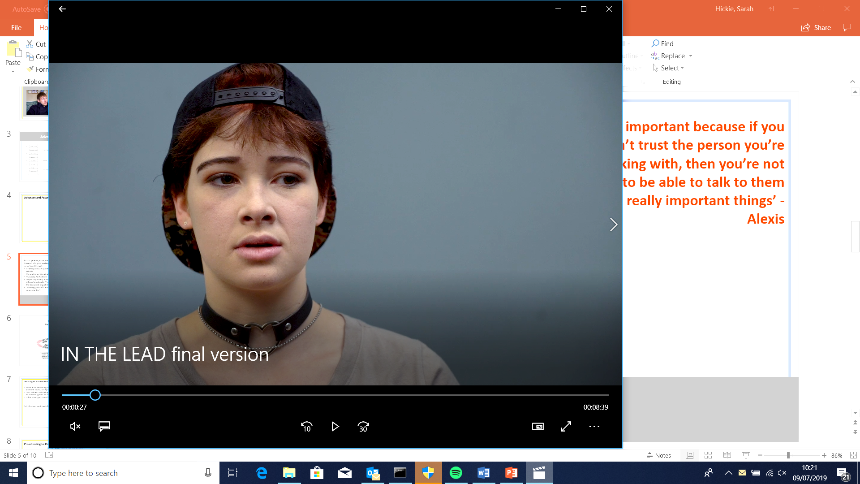
TRUST
“Trust is important because if you don’t trust the person you’re working with, then you’re not going to be able to talk to them about really important things”
Alexis
Notes:
Alexis is one of the young people who co-created the short film ‘In the Lead’ – available in the Informing Futures Toolkit.
This sounds so basic and obvious, but how often do we expect young people to start telling us sensitive personal information on a first meeting? It’s good to remember from the outset that building trust takes time, and that is OK.

Slide 5
HOW DO WE BUILD TRUST?
Trust is generally earnt, not given
We can’t make young people trust us, but we can work to be trustworthy by:
Being consistent, predictable and reliable
Managing expectations – being clear about what we can do, and what we can’t
Respecting privacy, being clear about confidentiality, and considering the impact of sharing information
‘Knowing our stuff’ and being honest about it when we don’t have answers
In a good support relationship, appropriate trust will exist on both sides
Notes:
Invite the group to share their experiences of what helps when building trust with young people, and record their answers on a flipchart
How can we behave to encourage young people to trust us?
How can we see when young people are developing more trust in us?
What do we see when young people don’t trust us?
(If you have a large group you may want to break into smaller groups to facilitate discussion.)
Now ask the group to share their experiences of putting trust in young people.
How can we demonstrate that we have trust in young people?
When has that trust been rewarded, and when has it led to disappointment?
How do these experiences shape the way we interact with young people?
Again, record useful key points on the flipchart.
Reveal the key points on the slide and draw out the key points from your discussion. Remember – the process of building trust is as individual as the relationship, so be prepared to take time over it.

Slide 6


SEEING THE GOOD
“A weed in the mud to a flower in blossom”
Rowen
Notes:
How does reading this quote make you feel?
In his interview for the film ‘In the Lead’ (available to view on the toolkit website) Rowen talks about how good support can help you go from feeling like a ‘weed in the mud’ to ‘a flower in blossom’ . When meeting with the young people involved in this film their own perceptions of themselves could sometimes be quite negative. Young people who have been in care or custody are also very aware of the negative perceptions some people hold of them, and face stigma.
Quotes taken from a literature review done by Coram Voice and Bristol University:
‘You say you are in care and lots of people feel sorry for you. I hate that feeling.‘
‘All people have certain views on people in care. They think we were troublemakers’
What are the changes needed to support a Young Person to see themselves as a flower?

Slide 7

SEEING THE GOOD – GROUP ACTIVITY
“‘A weed in the mud to a flower in blossom”
Rowen
In your groups annotate our weed and flower…
How might someone describe a young person/ care or custody leaver from a ‘weed’ perspective?
How might someone describe them from a ‘blossom’ perspective?
We’ll then come back together to discuss.
Notes:
Prompt questions:
‘A weed is but an unloved flower’
‘A weed is just a flower growing in the wrong place’
How can we as practitioners challenge the stigma that care and custody leavers face?
Is it important to work with family members and peers to challenge unfounded negative opinions?

Slide 8
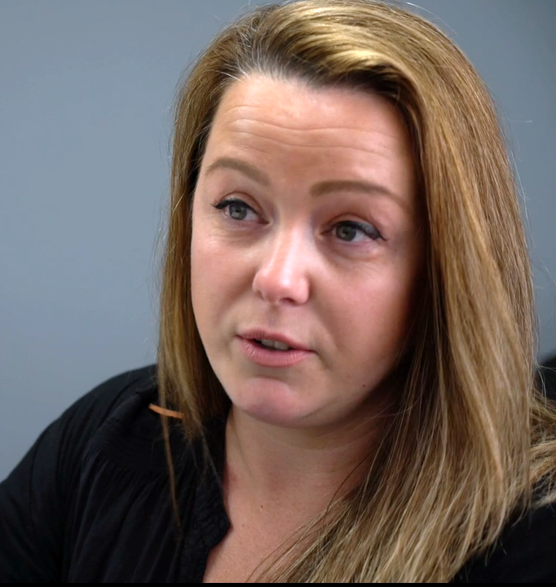
WORKING WITH VALUES
Values are the things which are important to us – those things which give our lives a sense of meaning and purpose.
Values act as an internal compass which guide us through life. For young people, identifying and understanding their own values can be very powerful.
Young people will have values – but they might need help to identify and ‘name’ them
Becoming more familiar with our values can help us decide on our direction when facing choices
Set of values sort cards for each of you to take away
‘I help young people see their strengths and successes, by trying to unpick it sometimes’ - Luci
Notes:
Values
Values are different to goals which have an end-point. Values are often life-long but also change over time. They could be thought of as those things we would like to be known or remembered for.
Everyone has values, but not everyone will be able to name them immediately.
Sometimes we may find we feel ‘out of sorts’ because we are not living in line with our values, or we used to value something that we no longer do but haven’t updated our behaviour accordingly.
Sometimes becoming clearer on our values can help to motivate us to make a positive change or try something new when we understand what behaviour aligns with a value.
Sometimes we have to prioritise certain behaviours and the values they support above others, for example we may need to prioritise ‘stability’ if our mental health is poorer and we know change can make it worse. We may need to prioritise a job that will give us money, or a job we can succeed in. We can’t always have it all, and this can be an important to understand and helpful when working with young people; what values are a priority and what can take a back seat?
Sometimes however, we will also have ‘core values’ that feel so important we won’t budge on them, and we are happiest when we are living in line with these.
On the next slide, we’re going to share an exercise anyone can use to explore their own values, individually, in a safe group setting or within support work.

Slide 9
WORKING WITH VALUES – ACTIVITY
Independently, take your Values Cards and as quickly as you can go through them creating piles that are:
‘Very important to me’
‘A bit important to me’
‘Not important to me’
With the person next to you, discuss a couple of the values from your ‘Very important to me pile’ that particularly stood out to you.
Notes:
For this activity, you will need to have printed out and prepared sets of values cards for participants to use. There are lots of sets available to download free from the internet – below is a link to one version which we have used successfully which includes 83 different values.
You can include as many or as few values as you wish in your set – bear in mind that the more options you provide, the longer the card sorting activity will take. You also need to ensure that every set includes the first 3 cards with the statements:
Important to Me
Very Important to Me
Not Important to Me
http://www.motivationalinterviewing.org/sites/default/files/valuescardsort_0.pdf

Slide 10
WORKING WITH VALUES
“When your values are clear, making decisions becomes easier”
Roy E Disney
“Values are like fingerprints. Nobody’s are the same, but you leave them all over everything you do”
Elvis Presley
Notes:
Take feedback from the group on the values card sort exercise. How did they feel about identifying and sharing their values? Was it easy to identify the important values, or did they have to think about it a lot?
The card sort is an exercise which can be done effectively with young people. You could even encourage young people to make or customise their own set of cards which reflect the language they would use to describe their values.
Often we require young people to make decisions they are unwilling to make. Taking a step back and spending some time with them on identifying their values, what is important to them, can help them to start to create a framework for making decisions and prioritising where they spend their energy.
Reveal the second quote
Values really are like fingerprints in that everyone has them – but they may not always be aware of them. Becoming more aware of one’s values can be really empowering and can help us shape ourselves into the people we want to be.

Slide 11
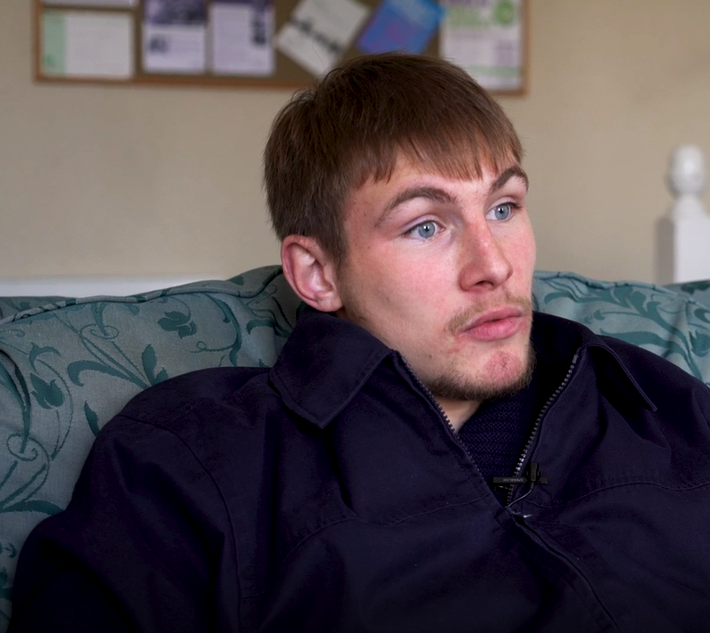
WORKING WITH VALUES
“I think being treated as an individual, for the system to work, each young person needs to be understood”
Rowen

Slide 12
RESOURCE LINKS
Values Cards Download
http://www.motivationalinterviewing.org/sites/default/files/valuescardsort_0.pdf
VIA values survey – a free survey that can be taken online which identifies your top twenty values in order of importance
https://www.viacharacter.org/

Slide 13
QUESTIONS?
Thanks for listening
Copyright© 2020. Informing Futures is a 1625 Independent People project. 1625 Independent People is a charity and a registered society (Co-operative and Community Benefit Societies Act 2014, reg: 23964R exempt from registration with the Charity Commission). Registered office: Kingsley Hall, 59 Old Market Street, Bristol, BS2 0ER.
This resource was funded by The National Lottery Community Fund and is offered free for information, educational and professional development purposes • You may not sell this work, nor may it be used as supporting content for any commercial product or service • All copies of this work must clearly display the original copyright notice and Informing Futures website address • Any on-line reproduction must also provide a link to the Informing Futures website.

