Slide 1
YOUNG PEOPLE IN THE LEAD TRAINING
Modules available in this series:
Module 1: Facts About Care & Custody
Module 2: Trauma Informed Working
Module 3: Building Relationships
Module 4: Developing Independence
Module 5: Spaces & Places
Module 6: Boundaries
Module 7: Consultation & Participation
Module 8: Staff Wellbeing

Slide 2


MODULE 2
Trauma Informed Working
This resource is part of the Informing Futures toolkit www.informingfutures.co.uk It was co-created with young people, and reflects what they felt practitioners most needed to understand in order to work successfully with care and custody experienced young people.
For more information or queries on any of the topics covered in this toolkit, or to find out about training and consultancy we can offer please contact enquiries@1625ip.co.uk
Special thanks to all the young people who took part in YPIL directly or supported our research for these resources: Ahmed, Alexis, Ashraf, Curtis, Ethan, John, Michael, Nikita, Rowen, Tia-Louise, & Tyler-Jack
Copyright© 2020 Informing Futures is a 1625 Independent People project.
Copyright© 2020. Informing Futures, a 1625 Independent People project.
Notes:
INTRODUCTION
This training is based on collective learning from 7 years of trauma informed work with complex young people, and also from our experience of working with partner agencies and practice sharing.
The session aims to introduce the importance of staff wellbeing as a foundation for not only a happy workforce but for effective service delivery. It will not answer everyone’s wellbeing questions, but will provide some tools for starting a process of integrating personal and team wellbeing into your practice.
NOTE: This training takes an asset based approach, asking participants to think about what is good for their wellbeing rather than identifying problems. This is not intended to avoid or deny things that are causing poor wellbeing – but research suggests we are more likely to discover positive solutions when we focus our thoughts on positive things.
For groups who feel stuck in a mindset of identifying negatives, you may want to spend some time addressing this. There is a useful CBT resource to support people to think about changing unhelpful thinking styles here: https://www.get.gg/docs/UnhelpfulThinkingHabitsWithAlternatives.pdf
The Circle of Influence can also be a useful activity to support thinking about what is within our control to change. There is a free guide to using this activity with a group here: https://www.thensomehow.com/wp-content/uploads/2019/06/TS-Circle-of-Influence-Worksheet-2.0.pdf

Slide 3
OUR SESSION TODAY
What is Trauma?
Attachment, The Brain & Development
The Trauma Recovery Model
Taking Care of Ourselves
Notes:
Introduce the content of the session using the bullet points on the slide

Slide 4

BE SAFE
Look after yourself today
Take time out if you need to
Let someone know if you need to talk
Notes:
What we are going to discuss today touches on sensitive areas. Everyone has their own history and experiences so please be aware if this subject is difficult for you, and take time out if you need to in order to feel safe.

Slide 5

Notes:
Ask the group: Does anyone know what this warning sign signifies?
This is the symbol for radiation warning. Like radiation, trauma can be completely invisible and have very harmful long term effects. Unlike radiation, there are ways for people to recover from the damage it does.

Slide 6
WHAT IS TRAUMA ?
Emotional shock following a stressful event, sometimes leading to long term neurosis
A distressing or emotionally disturbing experience
Any physical wound or injury
Physical shock following this, characterised by a drop in body temperature, mental confusion, etc.
Notes:
Ask the group what they understand by trauma. This can be done most simply by having people call out their answers. You may choose to make a note of these on a flipchart if you want to capture them for reference.
Reveal the definition A standard dictionary definition reveals how complex the concept of trauma is. Trauma can be physical, emotional, or both. It can have physical , emotional and psychological consequences.

Slide 7
WHAT MIGHT BE THE EFFECTS OF TRAUMA?
Physical – anything from visible injury to less visible delays to physical development
Emotional – anything from visible distress to less visible emotional impairment
Mental – anything from visibly shaking with fear to less visible flashbacks and PTSD
Notes:
The dictionary mentions some things which might happen to people as a result of trauma. Ask the group in their experience, what might the effects of trauma be for people?
Reveal the answers - we use these definitions to help us think about the way things affect us - but in reality they are all interlinked. The effects of trauma are physical, emotional and mental and manifest in many different ways. Some of these can be observed more readily than others.

Slide 8









ADVERSE CHILDHOOD EXPERIENCES
Trauma can take many forms and happen at any time in a person’s life. The term ACEs* is used to refer to trauma which has occurred in childhood.
Research has shown clear correlations between ACEs and development of long term serious health conditions in adult life.
*Adverse Childhood Experiences
Abuse
Neglect
Household Dysfunction
Physical
Physical
Mental illness
Incarcerated relative
Emotional
Emotional
Mother treated violently
Substance abuse
Sexual
Divorce
Notes:
Research reference
*https://acestoohigh.com/2015/02/17/nadine-burke-harris-how-childhood-trauma-affects-health-across-a-lifetime/
ACEs are types of trauma which occur in childhood. To help us think about them, they have been classified using the 3 categories shown above. This is not to suggest that other types of experience are not traumatic, or that trauma which occurs outside of childhood is less damaging.
When dealing with trauma we should not attempt to make judgements about ‘how traumatic’ an experience might have been, or make comparisons between different people’s experiences. Every individual is different, and will experience things differently.
It isn’t our job to diagnose trauma. We use the term ‘trauma informed’ because we want to encourage an awareness of the possibility that people who present with complex needs or challenging behaviour may have experienced trauma.

Slide 9
WHY DO WE NEED TO KNOW ABOUT TRAUMA?
To maximise the effectiveness of the support we are providing to vulnerable people
To avoid re-traumatising people
To enable us to advocate for people who need more specialist support or intervention
NOT to diagnose people – this is not our job!
Notes:
Talk through the points above.
Maximising effectiveness of support – this is what the Trauma Recovery Model can help us to do and we’ll look at that in much more detail later
If we don’t understand the effects of trauma, we may risk causing it. Assessment processes, support structures, can all be potentially traumatic to go through – as we begin to work in a trauma informed way we will want to review the way we do things to make it work better for people
Advocating – some people will need specialist support we are not able to give. Often people who are challenging or complex are written off because they are hard to deal with. If we can overcome this and build relationship with them based on an understanding of their needs, we can become a gateway to them receiving the help they need from other services.

Slide 10

WHAT IS ATTACHMENT ?
“Attachment is a small person learning how to be a person from a big person”
Jonny Matthew, Trauma Recovery Model co-creator
Attachment begins even before birth
Babies & children form attachments with more than one adult
Attachment to the primary caregiver is very important
Attachment is about everything we do to connect
Through attachment, we learn how to view ourselves and the world around us
Notes:
Attachment is a complex subject and one on which lots of material has been written. Reduced to its simplest form, though, it is the way we learn from the adults around us. This learning begins even before birth, and our experiences in our earliest years are key to healthy development, even though we may not be able to recall these years as adults.
In our early years we learn whether quickly about whether the world is going to meet our needs or not – when we are hungry, are we fed? When we are cold, are we clothed? When we are distressed, are we comforted? Babies absorb their experiences as learning even though they cannot name them.
Attachment shapes whether we learn to view the world as essentially good or benign, or essentially hostile and threatening.

Slide 11
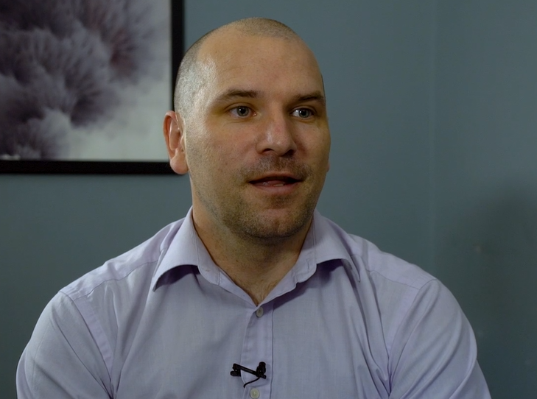
WHAT DOES POOR ATTACHMENT LOOK LIKE ?
“The majority of relationships, with the significant adults in their lives, that should have been positive, nurturing, have been negative”
Andrew, YOT worker
Notes:
This is Andrew – a YOT worker in South Glos, and this is a quote from the film made by Future 4 Me young people. (You can see the full version on the Informing Futures Toolkit website). He’s talking about the young people he works with in the YOT, and his quote demonstrates exactly the reality of poor attachment – relationships which should have been nurturing have been negative.

Slide 12


THE ‘FIGHT OR FLIGHT’ RESPONSE
FEAR
DANGER
SAFETY
Notes:
In a ‘normal’ danger situation, our brain prompts us to move away from danger and toward safety. To aid us in this we are flooded with adrenalin to enable us to think and move quicker. This situation is often referred to as the ‘fight or flight’ response. In it we are empowered to secure our own safety by using our brain and body to make the decision that will most effectively make us safe.

Slide 13
WHEN ‘FIGHT OR FLIGHT’ FAILS
CONFLICT
FEAR
SAFETY
?
?
DANGER
Notes:
Now let’s look at how trauma might affect the way the brain responds to danger.
Danger is present and this triggers fear – so far the same as in the previous example.
But what if the source of danger is an adult who is also a source of safety, a caregiver? Now the brain is conflicted. It does not know how to move away from the danger or how to seek safety.
The same chemical responses, designed to help us move and think quickly, are happening – and serving only to heighten the sense of confusion. The child may experience a feeling of being ‘trapped’ as the brain is unable to determine a safe course of action.
Children who are repeatedly exposed to this conflict may develop a range of coping mechanisms which focus on taking them out of the situation mentally (disassociation) or emotionally (substance misuse, self harming, challenging behaviour).
When this experience is repeated over and over again, it has a significant effect on the way the brain develops. A child traumatised in this way does not learn how to differentiate between danger and safety, and this will affect future behaviours, choices and relationships.

Slide 14

THE EFFECTS OF TRAUMA ON DEVELOPMENT
Trauma impacts on:
By the time teenage years are reached:
Physical Health
Cognition
Emotions
Relationships
Mental Health
Behaviour
Brain Development
Developmental age may be very different from physical age
Do our services recognise this?
Notes:
Invite the group to suggest some of the behaviours and symptoms they might see which could point to the presence of trauma:
Physical Health – sleep disorders, eating disorders, impaired immune system, cardiovascular disease, shorter life span
Cognition – Difficulty problem solving, language delays, problems with concentration, poor academic achievement
Emotions – difficulty controlling emotions, trouble recognising (naming) emotions, limited resilience to stress, powerful feelings of shame or guilt, excessive worry, feelings of hopelessness
Relationships – Attachment problems, poor understanding of social norms, inconsistent/no boundaries, difficultly forming and sustaining relationships
Mental Health – Depression, anxiety, negative self image, PTSD, suicidal thoughts/behaviours, flashbacks
Behaviour – Poor self regulation, social withdrawal, aggression, risk taking, substance use, self harming
Brain development – smaller brain size, less well developed connections, impaired stress response
Questions for reflection (not necessarily to be answered in this session!)
Do our services recognise the difference between physical age and developmental age?
If our eligibility criteria is age based, do we reflect on the developmental range that encompasses?
How does this shape our expectations of our service users?

Slide 15
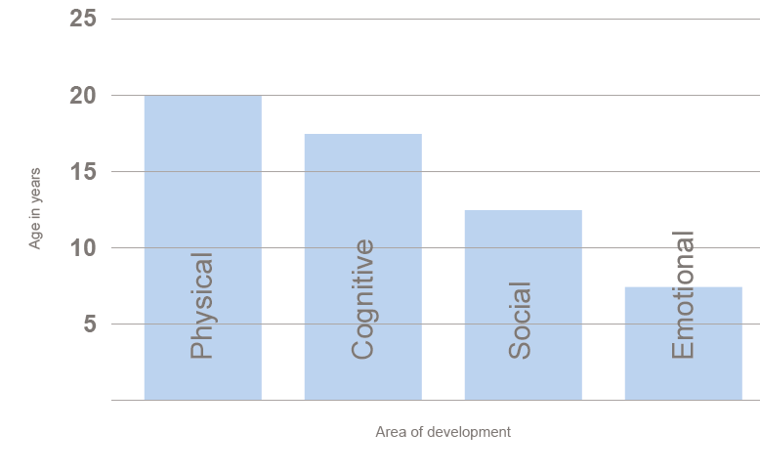
DEVELOPMENTAL MAPPING EXERCISE © Tricia Skuse
You will need the Development Mapping Exercise PDF and Developmental Mapping Profiles PDF
In small groups:
Identify the young person you are going to consider
In each category, discuss where you feel your young person sits in terms of age
Use questions on the handout to help you
Try to reach a group consensus
Remember – they may present as younger or older than their actual age and this may vary across the 4 areas
We’ll come back together to discuss.
Notes:
Give out the 2 handouts referenced and allow 10-15 minutes for discussion and working through the exercise.
Take feedback. What differences did people find between ‘real’ age and developmental age? Was this surprising?
Does this approach change what you might expect from your young people?

Slide 16

IN SUMMARY
People may not be as they first appear
Being Trauma Informed means taking the time to explore with people what they need in order to move forward
Notes:
Invite questions or comments from the group on the content so far. The next section moves into looking at the Trauma Recovery Model and how it can be used in practice.

Slide 17
THE TRAUMA RECOVERY MODEL
A way of looking at what a young person’s Presentation tells us about their Need, and working out what Intervention is most likely to succeed.
Presentation
Need
Intervention
If we step back, this can help us in service design and planning…
…or if we zoom in, we can use it with individuals to inform assessment, planning and delivery of support
Notes:
The Trauma Recovery Model can be used to help us work with complex young people. It helps us take what we know about how the young person PRESENTS and think about what that might tell us about their underlying NEED. When we understand that we can think more effectively about what interventions will be most helpful.

Slide 18
Confidence – Achieving Goals
Future Planning
Insight/Awareness
Cognitive threshold
Working Through Trauma
Ready to disclose
Trust/Relationship Building
Ready to build relationship with adults
Instability/Chaotic
Foundational Belief - Redeemability
Notes:
Give out copies of the TRM handout with the Triangle Model on it
Foundational Belief – Redeemability
How we feel about the life chances of our young people actually makes a difference to those life chances. What a responsibility.
Research with young offenders indicates that their worker’s optimism about their redeemability can influence their ability to transform their lives, sometimes referred to as the ‘Pygmalion Effect’: Maruna, S.; LeBel, T.P.; Naples, M. & Mitchell, N. (2009) Looking-Glass Identity Transformation: Pygmalion and Golem in the Rehabilitation Process. In Veysey, B.M.; Christian, J. & Martinez, D.J. (Eds) (2009) How Offenders Transform Their Lives. Cullompton: Willan Publishing.
Click to build the triangle from the bottom up, talking through the levels in more detail using the TRM handout.
Could encourage the learners to put up their hands at any behaviours they recognise in their own service users at each stage to encourage engagement.
There are 3 signs we are particularly interested in which can signal young people are moving into a new stage –
Readiness to build relationship with adults which usually signals moving from level 1 to level 2
Readiness to disclose, which usually signals moving from level 2 to level 3
Cognitive threshold –The ability to think and reflect about their experiences – which usually signals moving from level 3 to level 4
Reveal the arrows – of course for the purpose of the diagram we’d like to think that a young persons progress will be like the arrow on the left – but in reality it will be more like the scribble on the right! Young people will move backwards and forwards between the levels, and sometimes hover on the borders. In some cases, young people may appear to be at different levels in different areas of their lives. This isn’t a problem, because the model isn’t about boxing people in. Whatever it reveals can be useful for us in thinking about and planning support.

Slide 19
SEQUENCING INTERVENTIONS
“A good thing at the wrong time, is the wrong thing”
Notes:
Ensure everyone has a copy of the TRM triangle handout they can see.
Talk briefly through the needs and interventions linked to each layer.
Explain the importance of matching interventions to need:
‘ A good thing at the wrong time, is the wrong thing’ – and it can even be a bad thing. A strength of the TRM model is that it enables professionals to reach consensus about what is the right intervention NOW, and helps avoid situations where unrealistic goals are set for young people.
And the importance of sticking to an approach until progress is seen to the next stage. Too often we move ahead because we are impatient for change, not because the young person is ready.

Slide 20
Remember CPR
Consistency
Predictability
Reliability
Notes:
An easy acronym to remember the lifesaving principles for working with people who have experienced trauma – particularly at the lower layers of the TRM triangle

Slide 21
HOW CAN THE TRM MODEL BE USED?
As the basis for a formulation process:
A psychological formulation is a structured approach to understanding the factors underlying distressing states in such a way that it informs the changes needed and the mechanisms and treatments for such change to occur.
Multi agency information gathering, supervised by a lead worker
Multi agency meeting, led by a psychologist who creates a timeline of the young person’s life using the information everyone else brings
Psychologist leads the process of planning support interventions
Interventions agreed by the multi agency group and delivered by the professional with the best/most appropriate relationship
Report written by psychologist and shared with the multi agency group
Notes:
Check understanding with the group – who has used a formulation approach in their work before? How did they find it? If the idea is new, go over the slide above which outlines key points in the process.

Slide 22
USING THE TRM APPROACH CAN HELP
US MOVE FROM BEING…
To
Service Focused
Offer based on our resources, our strengths and our agendas
Engagement requires attendance and compliance
‘Success’ requires linear progression
Emphasis on ‘doing to’
Person Focused
Offer based on the needs of the young person
Engagement is flexible and adapted to young person’s strengths
Progression is individually defined
Emphasis on learning together

Slide 23

TRM IN PRACTICE – GROUP EXERCISE
Each group will be given one or two case
studies to discuss:
Based on the information you have, what level is this young person at on the TRM?
What needs can you identify, and what interventions would benefit them?
Who might be best placed to deliver these interventions?
Notes:
The TRM can also be used without the aid of a psychologist as a tool to inform your own support planning. It works best when two or more people use it together. It is a helpful tool in case reviews, supervision or team meetings.
We’re going to try an exercise to see how you might use it in real life. If you are in a group who are all working with the same service users, you could use an existing case to discuss. If not, use the examples given (distribute TRM case studies handouts if needed)
Take feedback from each group – their answers to the questions on the slide, and any observations about the process of discussing the case.

Slide 24
MULTI AGENCY WORKING - CHALLENGES
What are the common challenges which hinder good multi agency working?
How can a TRM approach help?
By providing a simple to share framework to discuss and review cases
Informed sequencing of interventions prevents duplication, and maximises everyone’s resources
Understanding underlying need prevents agencies from setting young people up to fail
A clear case lead ensures effective communication and keeps the case moving
Notes:
Ask the group to share their experience of challenges to multi agency working – you can record these on flip chart paper or just have them shouted out in the room.
Reveal some of the ways the TRM approach can help to support good multi agency working:
Simple to share – the model is quick and easy to explain even to people who have not had the training
Sequencing – so often agencies are doing similar work at the same time and this can be very confusing for the young person! Getting everyone to talk about what they are offering helps avoid this. It is really important that this is done in an atmosphere of trust so people don’t feel they have to be defensive about their work
Misunderstanding what stage a young person is at or what can reasonably be expected of them is a common reason for support to fail.
Case leading – doesn’t have to be the most senior or experienced person – the case lead is responsible for setting up the meeting, ensuring everyone knows what is expected of them, circulating actions and organising follow up communication or reviews

Slide 25
HOW COULD IT WORK FOR YOU?
In pairs or small groups:
Discuss what you are already doing to work in a trauma informed way
What can you take away from today to inform the work of your service?
Notes:
Take feedback if time allows – it can be helpful for the room to hear different ideas about how this could be taken forward

Slide 26
TAKING CARE OF OURSELVES
Working with trauma is demanding and takes a toll. What are your protective factors? Are they sufficient?
Regular supervisions
Reflective practice
Access to psychology support or clinical case reviews
Space and time to process your own feelings
Healthy work life balance
Nutritious diet
Adequate sleep
Notes:
One of the first things we learn when being trained in first aid is not to put oneself in danger. In a first aid situation, it would be easy to rush in without taking stock and become another casualty. Similarly with trauma, it is easy to react without thinking about the emotional and physical cost. Taking care of yourself is vital if you want to be able to care effectively for others.

Slide 27
QUESTIONS?
Thanks for listening
For further resources and information about the
Trauma Recovery Model, please visit www.trmacademy.com
Copyright© 2020. Informing Futures is a 1625 Independent People project. 1625 Independent People is a charity and a registered society (Co-operative and Community Benefit Societies Act 2014, reg: 23964R exempt from registration with the Charity Commission). Registered office: Kingsley Hall, 59 Old Market Street, Bristol, BS2 0ER.
This resource was funded by The National Lottery Community Fund and is offered free for information, educational and professional development purposes • You may not sell this work, nor may it be used as supporting content for any commercial product or service • All copies of this work must clearly display the original copyright notice and Informing Futures website address • Any on-line reproduction must also provide a link to the Informing Futures website.
Notes:
Copies of the TRM triangle schematic can be downloaded from the TRM academy site above (free but registration is required) You can also order poster sized versions and other associated resources from the same site.

