Slide 1


INTRODUCING RELECTIVE PRACTICE
This resource is part of the Informing Futures toolkit www.informingfutures.co.uk, a free online resource for professionals seeking to understand and support care and custody experienced young people.
For more information or queries on any of the topics covered in this toolkit, or to find out about training and consultancy we can offer please contact enquiries@1625ip.co.uk
Copyright© 2020. Informing Futures, a 1625 Independent People project.

Slide 2
Training Aims
Develop a common understanding of Reflective Practice
Explore the benefits of Reflective Practice in the context of our work

Slide 3

Who Is in the room today?

Slide 4

WHAT is Reflective Practice?
Reflective practice is the process of examining one’s own experiences to see what can be learned from them.

Slide 5

Discussion
In pairs or threes:
What does reflection mean to you?
When, where and how do you use reflection in your life currently?

Slide 6

Reflection as Learning
Reflection is a valuable way that we learn, and an important tool for recognising when things need to change.

Slide 7
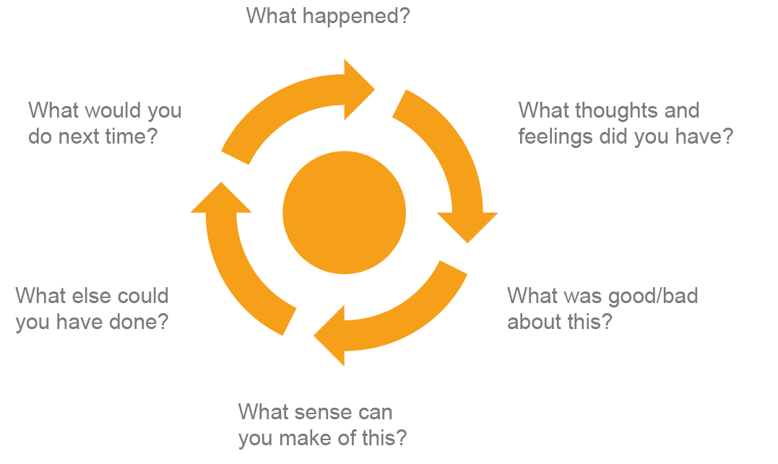
The Gibbs Model

Slide 8

Three Question Summary
What?
So What?
Now What?

Slide 9

Exercise
In pairs or threes:
Person 1 : think of something that happened to you this week
Person 2: ask Person 1 each of the questions in the Gibbs Model
Person 3: (optional) Listen and feedback

Slide 10
Group Reflective Practice
A safe environment in which practitioners can honestly assess their practice without fear of judgement or reprisal
Clear purpose
Safety and confidentiality
Ownership of the process

Slide 11
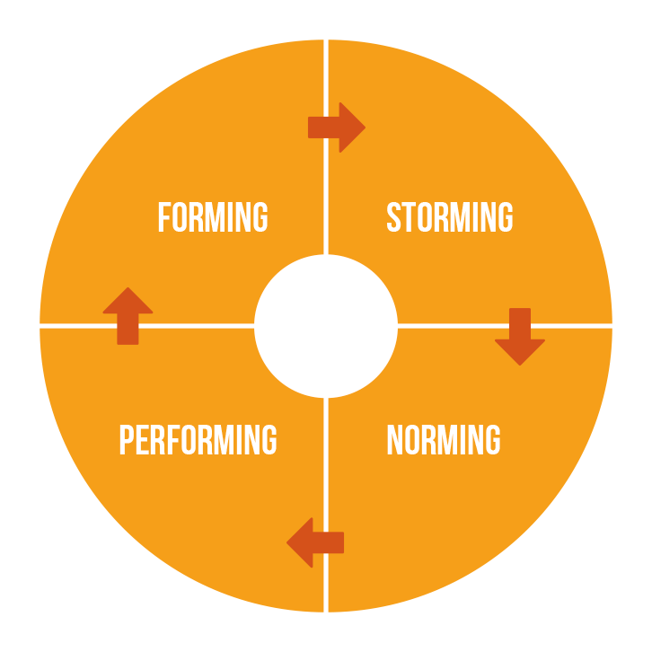
Group Development

Slide 12
Discussion
In pairs or small groups, discuss:
Do you have experience of belonging to a group or team which worked well together?
Can you identify with the stages of forming, storming, norming and performing?

Slide 13

The Role Of Facilitator
Set up the room and welcome the group
Enable all members of the group to take an active part in reflection
Prompt with questions where appropriate
Over time, assist the group to become self managing
Help the group keep to time

Slide 14
QUESTIONS?
Thanks for listening
Copyright© 2020. Informing Futures is a 1625 Independent People project. 1625 Independent People is a charity and a registered society (Co-operative and Community Benefit Societies Act 2014, reg: 23964R exempt from registration with the Charity Commission). Registered office: Kingsley Hall, 59 Old Market Street, Bristol, BS2 0ER.
This resource was funded by The National Lottery Community Fund and is offered free for information, educational and professional development purposes • You may not sell this work, nor may it be used as supporting content for any commercial product or service • All copies of this work must clearly display the original copyright notice and Informing Futures website address • Any on-line reproduction must also provide a link to the Informing Futures website.

