Slide 1


IMPLEMENTING A PIE FRAMEWORK
Implementing a Psychologically Informed Environment (PIE) framework
This resource is part of the Informing Futures toolkit www.informingfutures.co.uk, a free online resource for professionals seeking to understand and support care and custody experienced young people.
For more information or queries on any of the topics covered in this toolkit, or to find out about training and consultancy we can offer please contact enquiries@1625ip.co.uk
Copyright© 2020. Informing Futures, a 1625 Independent People project.

Slide 2
IMPLEMENTING A PIE FRAMEWORK
The starting point for 1625ip’s journey could be located at numerous different points…
For the purposes of this guide we have chosen 2010 which reflects the planning stage for Future 4 Me, the point at which we decided to write our ‘PIE’ down and the beginnings of where it became a ‘conscious’ framework for us as a charity.
In thinking about a ‘starting point’, it’s important to acknowledge that this was not something miraculous that suddenly appeared in the charity, but brought together what we already knew and had as good practice with emerging thinking and good practice in this area.
We expect this will be true for you as well

Slide 3
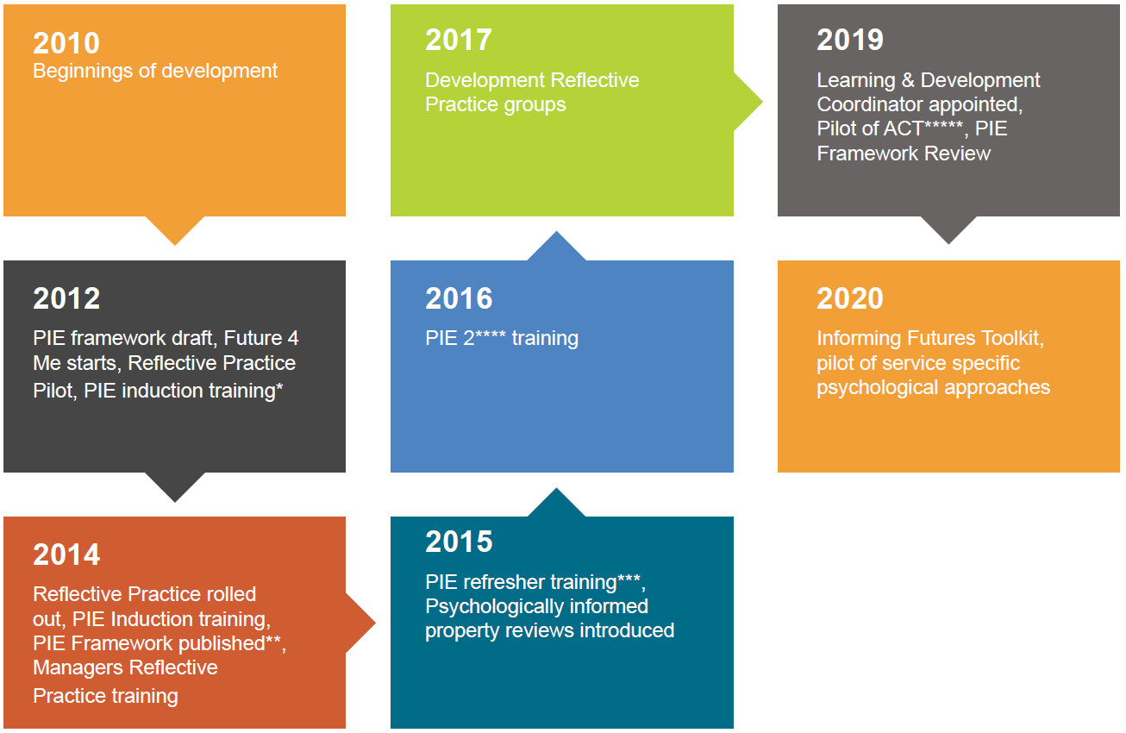
TIMELINE OVERVIEW
2014
Reflective Practice rolled out, PIE Induction training, PIE Framework published, Managers Reflective Practice training.
Housing Care and Support Journal - Implementing a psychologically informed environment in a service for homeless young people.
2019
Learning & Development Coordinator appointed,
Pilot of ACT*****, PIE Framework Review
Piloting of Acceptance and Commitment Therapy as the underpinning approach in our Reboot West programme
2015
PIE refresher training, Psychologically informed property reviews introduced
Training provided to teams offering a ‘refresh’ on specific aspects of 1625ip’s PIE framework
2016
PIE 2 training
Ongoing programme of training throughout the year offering a deeper dive into specific aspects of 1625ip’s PIE framework
2012
PIE framework draft, Future 4 Me starts, Reflective Practice Pilot, PIE induction training
This is induction training for all colleagues that provides a guide to 1625ip’s PIE framework and how this can be applied in our work

Slide 4
TIMELINE NARRATIVE
2010 - Beginnings of development – reflecting trend in wider homelessness services sector in becoming more’ psychologically informed’. Provided 1625ip with opportunity to ‘formulise’ framework of provision
2012 – 1st Draft of the first young people specific PIE framework looking specifically at Homeless YP, Future 4 Me starts, and linked to this our Reflective Practice Pilot (more about this later) and the introduction of PIE induction training (external delivery initially)
2014 – Reflective Practice rolled out across approx. 100 staff (facilitators trained to use peer facilitated model), PIE Induction training becomes internally led reflecting learning and ‘growing maturity as a PIE organisation, PIE Framework published (peer review), all managers trained as RP reflecting their role in RP groups & as line managers
2015 – further embedding PIE and thinking about how we can keep it alive and relevant for staff, developed PIE refresher training, PIE property reviews introduced. Learning framework reviewed

Slide 5
TIMELINE NARRATIVE
2016 - PIE 2 training – again thinking about how we can further embed and keep this alive, we set up PIE 2, an annual rolling programme of training covering different aspects of PIE in more detail. Examples include; INSERT
2017 - Development Reflective Practice groups, Future4Me 2 starts and the beginnings of the development of a National Toolkit for YP with experience of care and custody
2019 – Learning & Development Coordinator appointed, Development RP groups, Pilot of Acceptance and Commitment Therapy as the psychological framework for Reboot West, a specialist EET service for Care Leavers, PIE Framework reviewed and updated
2020 – Future4Me National Toolkit (care and custody leavers) published, pilot service specific approaches, Development of a multi-agency project to support RP delivery. Learning framework review; RP facilitators Support and development framework updated

Slide 6
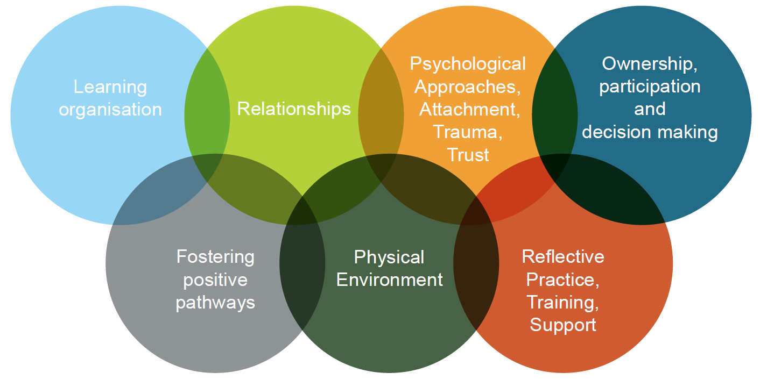
CENTRAL PRINCIPLES

Slide 7
CENTRAL PRINCIPLES
A wide range of resources and guidance are available in relation to what a PIE framework might look like. Some organisations have based their work on other ‘generic’ frameworks and some have developed their own. We were keen to develop something that specifically reflected our work with Young People who are or are at risk of homelessness including care and custody leavers.
Our original framework had 9 central aspects, in our current review this has reduced to 7 reflecting our learning about how we work with these in practice and the links between different aspects (2 original principles that were integrated are; ‘Graded sanctions’ - this became part of ‘Ownership, participation and decision making’ and ‘Psychological approaches’ and ‘Attachment trauma and trust’ were combined.

Slide 8
CENTRAL PRINCIPLES
Things to think about:
These 7 principles act as the golden thread through everything that we do – what would be the right principles for you? What would would be the best way to link them which makes sense to colleagues?
Once you have your principles, what do you already have in place?
What do you need to develop / create?
What are ‘quick wins’?
What is the smallest actions that will create the most value?
What are the bigger projects that need more resourcing and time?

Slide 9
RESOURCES THAT SUPPORT OUR PIE

Slide 10
RESOURCES THAT SUPPORT OUR PIE
This identifies 3 broad groupings of people; our Senior Leadership Team, our wider colleagues and the external support we needed to enable us to develop, implement and stay on our learning and development journey with PIE
This will vary for different organisations, and, if we had sat down at the beginning, I’m not sure we would have been able to articulate this is what it would look like (Hindsight is a great thing!). However this reflects our learning – we didn’t always anticipate what was needed but this also enabled us to flex and evolve to meet challenges and changing circumstances

Slide 11
RESOURCES THAT SUPPORT OUR PIE
Things to think about:
The development work will take additional capacity, what structures will support learning along the way?
Who is best placed to do this?
What additional resources can you bring in?
What development opportunities does this give colleagues in your organisation?

Slide 12
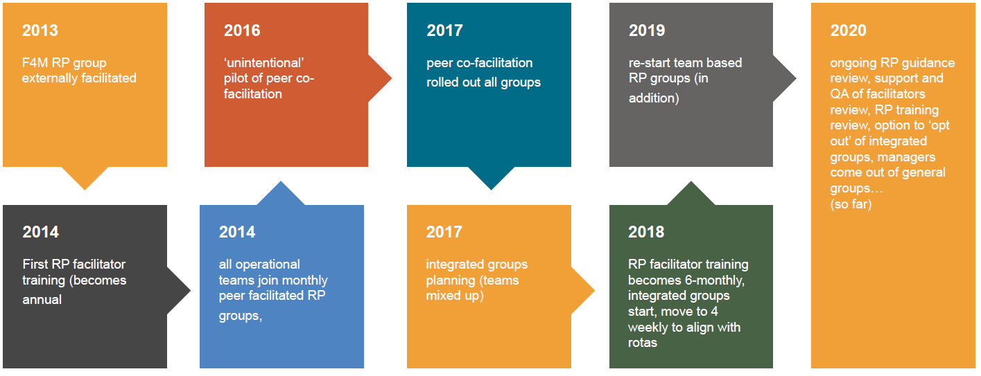
Reflective Practice A Journey

Slide 13
Reflective Practice A Journey - Narrative
Our principles:
Based on Gibbs model
Peer facilitated (co-facilitated)
Ensuring valuable learning is captured from groups
External clinical supervisions for facilitators
Internal logistical support for facilitators

Slide 14
Reflective Practice A Journey - Narrative
Resources:
We needed to find model that would enable facilitators to be drawn from within teams as not sustainable to rely on external facilitation
This takes time and several iterations and the process is NOT linear!
This has also taken and remains a commitment to a significant investment of colleagues time to support groups and facilitators
External consultants support has been key
It has been crucial to have senior leadership and management commitment to support time and resources commitment needed and to enable colleagues to prioritise RP groups

Slide 15
Reflective Practice A Journey - Narrative
Reflection:
We mention above that to get to our current RP model has taken time and several iterations. We also see this as an ongoing journey that will continue to, at times, zig zag and revert to includes aspects previously paused, as well as include new developments.
We also recognise that each iteration will have important gains and some compromises e.g. moving from team based groups to mixed team groups, meant colleagues were generally more comfortable in groups and there were significant benefits for cross-team learning, however there was some compromise for team learning and development (so a later iterations adjusted for this again!)

Slide 16
RP – Challenges and Solutions?
Challenges:
Not always about solutions to start with
How to get learning and solutions embedded
Some colleagues not seeing the overall benefits of managers being in general groups with direct workers
Facilitator turnover
Logistics management

Slide 17
RP – Challenges and Solutions?
Solutions - Resources:
Increased frequency of training programme
Logistics support, allocated part of project support role
Investment in meeting rooms
Remain open to reviewing group structure

Slide 18
RP – Challenges and Solutions?
Solutions - Culture shift :
Initially RP was met both enthusiasm and reluctance.
Leadership & management support is crucial.
Robust structures in place enables cultures to shift.
Need to build critical mass of people in support of RP to enable the more cautious time to adapt.
See RP as a skill that can be learned & acknowledge it doesn’t always come naturally Through peer - facilitation, created champions and ambassadors, embedded in teams & provided real development opportunity for colleagues
RP has become a core part of everyone’s role not an added extra – supported by seniors leaders & managers
Culture shift in relation to prioritising RP over ‘urgent work’ that comes up

Slide 19
PIE Training Programme Over Time

Slide 20
Training – Learning and Changes
Content and context:
External supervision and internal operational support
External to internal delivery where possible; enables development opportunities for colleagues; means trainers have organisational context and better placed to show applications.
Design of content has become more practical, with relevant theoretical input that is useful for colleagues in their day to day practice - enabling application of theory into practice.

Slide 21
Training – Learning and Changes
Training design over time has evolved to address:
Tension between psychological needs and service/contract pressures. e.g. length of stay pressures; Doing the best we can, Knowing the flexibility of contract pressures can help, Acknowledging the tensions can be helpful & drawing out how this looks in practice.
Variety of roles within the organisation and managing the different levels of comfort and knowledge in room. Embracing the challenge to make the training relevant and engaging for all colleagues. e.g. finance colleagues learning about attachment and trauma.

Slide 22
Training – Learning and Changes
Resources:
Huge resource commitment to train whole organisation initially and then ensure structure in place for ongoing training
Initial bespoke funding drawn in to support implementation, now built into all services funding
Creative in training development e.g. PIE Refresher used a vehicle that already existed and staff were able to determine training agenda
Have adapted length and frequency of PIE trainings to reflect organisational need

Slide 23
Training – Learning and Changes
Examples of PIE 2 training:
Solution Focused Approaches
Motivational Interviewing
Challenging Behaviour
Personality Disorders
Working with Psychosis
PIE and Environment
Introduction to Complex Trauma
Restorative Approaches
Acceptance and Commitment Therapy

Slide 24
Some Things We Are Currently Developing
Individual services piloting specific psychological approaches
Update of RP framework (focus on how we learn from RP and how this informs development & how we support and develop facilitators and delivery)
Extending work with partners to support joint development of RP
Essentially, this is a journey that we will continue…

Slide 25
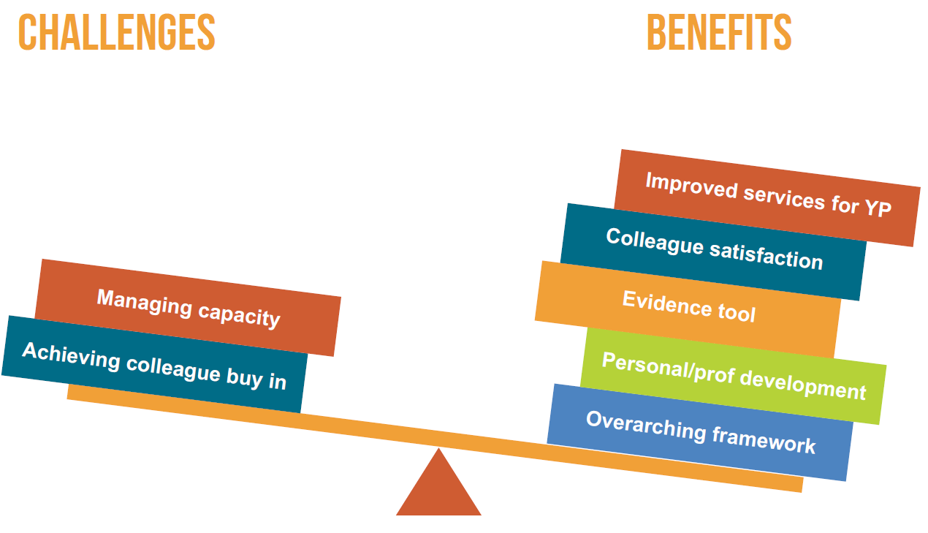
Summary

Slide 26
QUESTIONS?
Thanks for listening
Copyright© 2020. Informing Futures is a 1625 Independent People project. 1625 Independent People is a charity and a registered society (Co-operative and Community Benefit Societies Act 2014, reg: 23964R exempt from registration with the Charity Commission). Registered office: Kingsley Hall, 59 Old Market Street, Bristol, BS2 0ER.
This resource was funded by The National Lottery Community Fund and is offered free for information, educational and professional development purposes • You may not sell this work, nor may it be used as supporting content for any commercial product or service • All copies of this work must clearly display the original copyright notice and Informing Futures website address • Any on-line reproduction must also provide a link to the Informing Futures website.

