Slide 1

Technology Facilitated Abuse
&Young People
Written by
Clare Birch & Alice Williams
If you would like to discuss having our trainers deliver this session for your organisation, please contact enquiries@1625ip.co.uk
Copyright© 2025. Informing Futures is a 1625 Independent People project. 1625 Independent People is a charity and a registered society (Co-operative and Community Benefit Societies Act 2014, reg: 23964R exempt from registration with the Charity Commission). Registered office: Kingsley Hall, 59 Old Market Street, Bristol, BS2 0ER.
This resource was funded by The Quartet Community Fund and is offered free for information, educational and professional development purposes • You may not sell this work, nor may it be used as supporting content for any commercial product or service • All copies of this work must clearly display the original copyright notice and Informing Futures website address • Any on-line reproduction must also provide a link to the Informing Futures website.

Slide 2
Technology Facilitated Abuse
&Young People
Technology is constantly changing. ‘Smart’ devices are becoming more sophisticated and more integrated into every part of our lives. This tech can improve our lives. However, it also presents unique opportunities to harass, control, abuse and manipulate others. In this training we will explore some of the ways tech can be used to abuse people, and how we can protect against it, report it, and help victims/survivors to escape and recover.

Slide 3

Training Outcomes
Understand what is meant by technology facilitated abuse (TFA)
Recognise the signs that a person may be experiencing this form of abuse
Understand the impact of TFA on victims/survivors
Feel confident to offer support and signposting to young people experiencing TFA
Feel confident to support young people to report TFA to the police, if they wish to

Slide 4
Taking Care of Yourself Today
Talking about any kind of abuse can raise difficult feelings and emotions.
Each of us comes to this session today with a unique set of experiences, strengths and vulnerabilities.
Your wellbeing is a priority – no-one learns well when they are distressed.
So please take care of yourself as you are learning, and if you need to take a break or to seek some support, please do so.

Slide 5
A Word About Gender
Technology Facilitated Abuse can happen to people of all genders
Current research suggests that, as with domestic abuse, the majority of people who experience technology facilitated abuse identify as female
If we present more statistics about the experience of one gender than another, that is not intended to minimise anyone’s experience of abuse
All survivors deserve to be treated with dignity and respect, and offered support appropriate to their needs

Slide 6

Overview of Training
Part One – What is Technology Facilitated Abuse ?
Who is affected and how
Understanding key concepts and terminology
The pros and cons of social media
Password Hygiene
TFA and the law
Part Two – Supporting Young People with TFA
How Confident Are You?
The Big Four Social Media Platforms
Support Tools and How to Use Them
Dealing with Online Bullying & Harassment
Supporting with Revenge Porn
Reporting to the Police
Resources Roundup

Slide 7
What is Technology Facilitated Abuse?
Technology Facilitated Abuse (TFA) describes the misuse of technology as part of a pattern of abuse.
TFA can be defined as:
The misuse of technology to facilitate incidents of controlling, coercive, threatening behaviour, violence or abuse.
This could include, but is not limited to:
Psychological abuse Physical abuse Sexual abuse Economic abuse Emotional abuse
When this abuse is carried out by a family member, intimate partner or ex intimate partner, it is classed as a type of Domestic Abuse. When carried out by anyone else, it is classed as Stalking or Harassment.
All of these types of abuse are criminal offences.

Slide 8
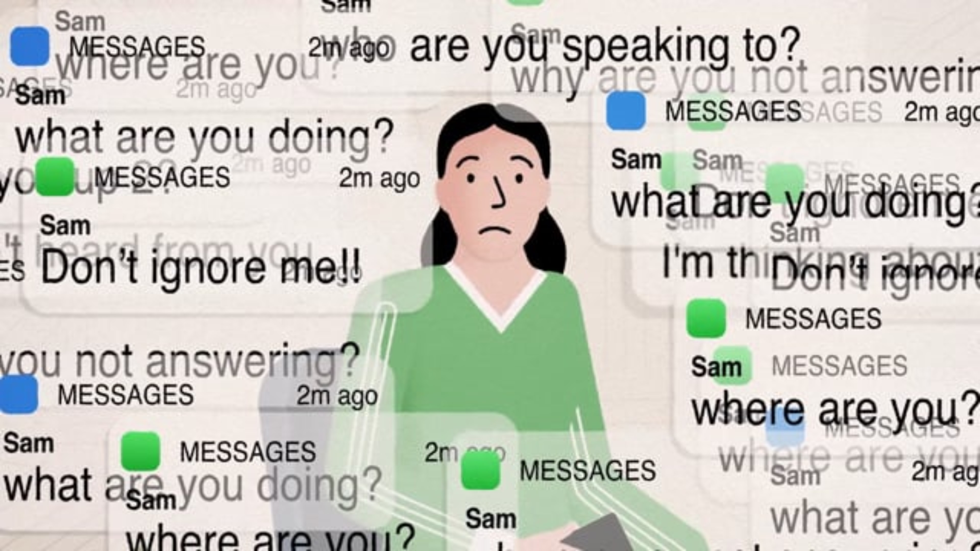

Slide 9

What is Digital Footprint ?
Digital Footprint (sometimes called digital shadow) is the unique trail of data that every individual creates when using the internet.
Your active digital footprint is all the information you intentionally share. For example:
Emails and text messages
Online forms you fill out and submit
Comments left on articles or videos
Social media posts
Your passive digital footprint is created by data you leave behind without meaning to, or without having a choice to.
For example:
Cookies and tracking data created by your web browsing activity
Geolocation data generated when using maps and other apps that track location
Your IP address, email address and other personal information that can be associated with your online activities.

Slide 10









What is the Internet of Things?
The Internet of Things (IoT) is a network of physical objects embedded with sensors, software and other technologies that connect and exchange data with other devices and systems over the Internet.

Slide 11


Internet of Things – Case Study
Lisa and Ben use an Amazon Echo to connect to their Nest thermostat, Ring doorbell, and touchpad smart lock. Ben installed all of these devices. Lisa is home alone while Ben is traveling when the lights suddenly go out. She uses a phone app to turn them back on – and they go out again. Feeling scared, Lisa leaves the house, hoping that the issue with the lights will be over once she returns.
When she returns home and enters the code into the touchpad on the front door's smart lock, the buttons flash red and the door remains locked. She tries again and, still, it is locked. She calls Ben. “Are you sure you're doing the right code? 1564?” Ben asks.
Later, while making lunch, Lisa starts sweating. She looks at the Nest thermostat: it is set to 90°F. Suddenly, the phone rings. “Why do you have the temperature set to 90 degrees on the Nest? What the hell are you doing?” “I haven't touched it!” says Lisa. “I'm turning it down,” says Ben. “Why can't you figure out these things? It's not that hard.” He hangs up.

Slide 12
Lisa is upset about the home device issues and how Ben is treating her. She calls her sister to talk through what's going on, and explains that Ben must be behind some of the issues. The chat is interrupted; Ben is calling again. She answers. Ben asks her how her night is going and asks if she'd “talked to her sister lately?”. Shocked, Lisa asks, “How did you know?”
“It's just a question. Why are you so paranoid?”.
Of course, Ben did know Lisa was talking to her sister. He knew because of an Amazon Echo feature that lets him use it as a listening device.
The “drop in call” feature is useful in some situations. For example, if someone is at home and their phone is dead or in another room, their partner can call them through the drop-in feature. If prior ‘permission’ has been granted, the Echo gives an alert and the call starts. With the use of an Echo Show (Amazon’s tablet) an abuser can create a makeshift home security system that allows them to ‘drop in’ on various tablets around the house. This is how Ben monitors Lisa’s activity.
Case studies taken from The Emerald International Handbook of Technology Facilitated Violence and Abuse, PenzeyMoog & Slakoff

Slide 13
Internet of Things – Staying Safe
Understand the risks
Increasing digital confidence
Making use of manufacturer support
Improved design
Legislation
Talking to someone about any concerns
Trauma Informed customer service
48 % of women could not name a home device they believed could be vulnerable to abuse
27% of women stated that admin access for connected devices has not been shared equally in their household
The UK government published a code of practice for the IoT in 2018. It sets out 13 guidelines aimed at protecting privacy and safety. It is not law –campaigners would like to see these principles brought into legislation.
Isolation is a key tactic of all abusers. The more people are aware of sources of support, the more likely they are to be able to access it.
The major UK banks offer specialist customer support for victims of domestic abuse. Many banks and retailers are also part of the Safe Spaces scheme.

Slide 14

Group Discussion - Forms of Online Harm
How many forms of online harm can you identify?
What do you know about how these harms affect the young people you work with?
10 mins

Slide 15
13 Forms of Online Harm
Threat of Physical Harm
Personal contact information shared without permission (doxing)
Blackmail
Lies posted about them (defamation)
Monitored, tracked or spied on
Accessing devices or accounts without permission
Impersonation
Repeated unwanted contact
Being called discriminatory or derogatory names
Networked harassment
Non-consensual use of intimate images (revenge porn)
Harassment due to a protected characteristic
Unwanted sexual images sent to them (cyberflashing)
Notes:
Source: (Supporting Safer Digital Spaces: Dunn, Vaillancourt & Brittain)

Slide 16

Who is at risk of Technology Facilitated Abuse?
Today we are focusing on young people, but ANYONE can be a victim of technology facilitated abuse – just as ANYONE can be a victim of other types of abuse.
A 2023 global study found that transgender and gender diverse people reported the highest proportion of incidents
The same report also found that LGBTQ+ people were much more likely to report a serious impact from online harms, compared to heterosexual and cisgendered people
(Supporting Safer Digital Spaces: Dunn, Vaillancourt & Brittain)
The ending of relationships is a major trigger. Police figures suggest that 80% of the technology facilitated abuse which is reported to them was initiated following a break up.
(Source: Avon & Somerset Constabulary)

Slide 17
What Young People Are Experiencing
Notes:
Figures refer to a survey of young people carried out by 1625 Independent People during 2024/25

Slide 18




Where Does Technology Facilitated Abuse Happen?
68%
68%
42%
42%
Avon & Somerset Constabulary figures suggest that 34% of cyber domestic abuse incidents involve social media as the primary avenue for abuse.
Notes:
Figures refer to a survey of young people carried out by 1625 Independent People during 2024/25

Slide 19
“ I was scared they would turn up at my house or where I work”
“it really affected my mental health”
“I was creeped out, and I felt violated”
“ I didn’t know what to do”
Notes:
Quotes from a survey of young people carried out by 1625 Independent People during 2024/25

Slide 20
What Young People Are Doing to Protect Themselves
Notes:
Figures refer to a survey of young people carried out by 1625 Independent People during 2024/25

Slide 21
TFA & Social Media – Case Study
K’s abusive ex-partner was relentlessly harassing her on facebook, sending her threatening messages and constantly commenting under her posts on her profile. His family members also joined in with this behaviour at times. K felt stuck in a cycle where her abuser would contact her, she would block his account, then he would create new accounts and the abuse would start again.
K was upset because she felt she would have to create a new facebook account in order to escape his abuse. She was reluctant to do this, because she didn't want to lose the memories she had on there.
K told a close friend, who showed her how to adjust her privacy settings. Now when she goes to share something or post something she can select to share with everyone except her ex-partner and their family members. This can be done using the 'default' audience setting and we will be showing you later in the training how to do this.
“I didn't know you could do this so it was eye opening. I can see what he posts but he can't see what I post. I do feel like this has made a difference because it has seemed to stop him for a while. I found it really useful as I was getting quite upset at the thought of making a new facebook. I didn't want to lose it and so this allowed me to keep it.’”

Slide 22
TFA and the Law
TFA is a crime
There are three main pieces of legislation under which TFA offences can be prosecuted.
The Computer Misuse Act 1990
The Domestic Abuse Act 2021
The Protection from Harassment Act 1997

Slide 23
The Computer Misuse Act 1990
Example offences under the Computer Misuse Act
Unauthorised access to computer material
An abuser hacks into their victims phone or laptop without permission
Unauthorised access with intent to commit further offences
An abuser hacks into their victims social media accounts and impersonates them, asking friends to send them money
Unauthorised access with intent to impair operation of the device
Abuser installs malicious software which enables access to the device camera
Making, supplying or obtaining articles for use in offences
Downloading malware or spyware – whether deployed or not
2 years in prison
5 years in prison
10 years in prison
2 years in prison

Slide 24
TFA and the Law – Revenge Porn
Intimate image abuse, also known as ‘Revenge porn’ involves the sharing of private explicit images of an individual without their consent.
This was made a specific sexual offence in 2015. The Online Safety Bill (2023) strengthens this legislation further. There is now no requirement to prove that the perpetrator ‘intended to cause distress’.
The offence carries a maximum sentence of 2 years in prison
Threats of revenge porn can also be prosecuted under the Domestic Abuse Act.
In cases of revenge porn, images are most commonly shared online – however the offence also applies to physical copies of images, such as photographs.

Slide 25
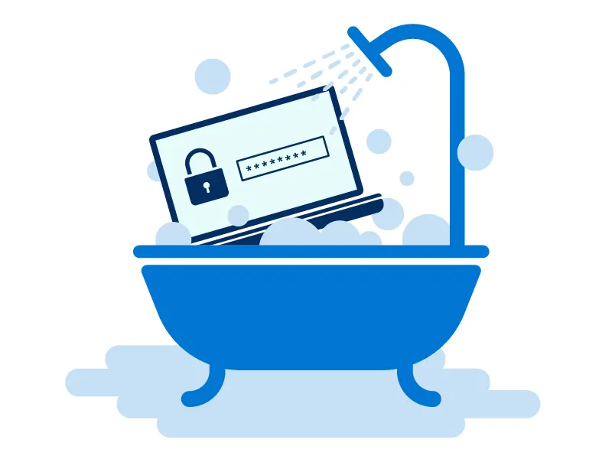
Password Hygiene
Change passwords regularly – especially after a breakup
Change secret answers and recovery information
Pay special attention to your email passwords as email accounts are a ‘gateway’ to LOTS of other information
Set a strong password that is not easily guessed – don’t use birthdays, pets names, house numbers etc
Use different passwords for all accounts
Use a reputable password manager app, or if you have a smart phone use the password manager within your phone, which will usually require biometrics to access

Slide 26




What Makes a Strong Password?
24% of Americans have used the word password, Qwerty or 123456 as their password
59% of U.S. adults have incorporated a name or a birthday into their password
27% have attempted to guess someone else’s password….
…. And 17% of those got it right!
DO
Use a minimum of 12 characters
Use special characters, letters & numbers
Use upper and lower case
Keep it random
DON’T
Use names, birthdays or house numbers
Use easily recognised sequences
Use common words or phrases

Slide 27



3 Tips for Setting Strong Passwords
3 Random Words
Condensed sentences
MfaniSasmgt
My favourite aunt’s name is Susan and she makes great trifle
Glasses
Dog
Cherries
Glass3sd0gcherr!3s
Use Auto Generated Passwords
Use an online Random Password Generator
Allow your smartphone to generate strong passwords – and remember them for you
Use a password manager. KeePass is a highly rated free open source password manager

Slide 28


Slide 29

Supporting young people with TFA
Listen & believe
Encourage online safety skills
Support with reporting
Signposting/resources

Slide 30
Discussion – How Confident Are You?
Review the safety actions on the next slide. How confident are you to
Carry out these actions yourself or
b) Support a young person to carry them out?
10 mins

Slide 31
Change passwords regularly
Choose strong passwords
Enable two step verification
Block an account/number/email address
Report abuse or harassment on the platform where it happened
Report fake accounts
Have accounts set to private
Turn on tagging permissions or disable tagging
Turn off location sharing
Avoid opening links/attachments from unknown senders
Manage account users on home devices
Cover camera on devices
Disable microphone
Enable fingerprint or facial recognition
10 mins

Slide 32
Getting Social Media safety savvy: The Big 4
Instagram
TikTok
Facebook
Snapchat

Slide 33
Instagram Safety & Privacy Options
Choose to have account public or private
Manage who tags you or @mentions you
Block specific accounts/comments from specific users
Control who messages you
Control who can see when you’re online
‘’Close friends’ option on stories
Hide stories and live from specific people
Restricted: take a break from someone
Limit interactions – temporarily limit people’s ability to interact with you
‘Mute’ someone – this stops their posts & stories showing up on your feed without blocking them
Hidden words: Hide custom words or phrases from comments or messages

Slide 34
TikTok Safety & Privacy Options
Account defaults to public when set up but can be changed to private
(under 18 accounts default to private but can be changed. Under 16 cannot be changed to public)
Control who views videos you post: Choose to make it visible to yourself, friends or community
DM’s can be set to everyone, friends or no-one
Decide who views your comments – just ‘friends’ or everyone. You can also turn comments off entirely
Comment filters – automatically hides offensive comments Option to hide custom keywords
Block accounts & remove followers
Report impersonation accounts
Prevent others from seeing videos you have liked
Turn off video downloads so people are not able to download your video

Slide 35
Facebook Safety & Privacy Options
‘Privacy Checkup’ tool
Select your ‘default audience’ for who see’s your posts
Limit past posts
View and review ‘blocked’ list
Friend request: limit this to just ‘friends of friends’
Turn off search engines linking to your profile
Select who can post on your profile and who can view posts
Can use ‘close friends’ lists to make sure they only see content
Option to review posts you’ve been tagged in before they appear on your profile
Blocklist filter: choose words, phrases or emoji’s you want to hide from your profile
If you receiving spam messages, consider changing your password and reporting account

Slide 36
Snapchat Safety & Privacy Options
Report snaps, stories or account
Option to hide something on ‘Discover’ page
Choice between My Story: Public or My Story: Friends
Screenshot feature: If you take a screenshot of someone’s snap they will get a notification
‘My Eyes Only’ feature allows you to move snaps and stories into ‘Memories’ where only you can view them by entering your passcode
Option to hide or block message from non-friend snapchatting you for the first time after you have viewed it
Choose who can contact you between ‘friends’ and ‘contacts’
Option in chats with friends to select ‘never delete’ so snaps stay there
You can keep messages longer if someone saves, replies or reacts to a message
Activate ‘Ghost mode’ so your location won’t be visible to anyone on the Snap Map or turn off location sharing in your phone and this will have the same effect

Slide 37
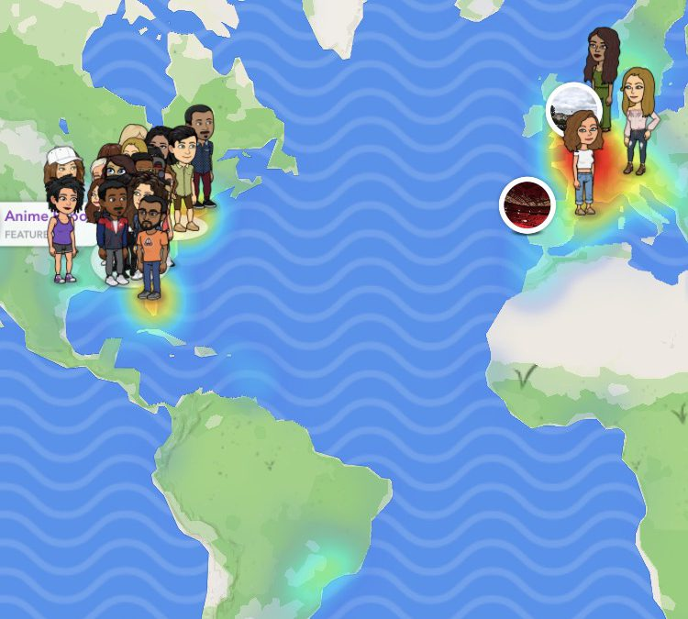
SnapMap
The SnapMap is a feature on Snapchat which allows users to see each other’s locations on a map.
It is important to be aware of this location sharing feature of the app, and how to turn it off, as it can share location information up to and including street names and building numbers.
Activate ‘Ghost Mode’ to remove your avatar from the map – or turn off location sharing in your phone settings.
https://learnsafe.com/the-dangers-of-snap-map-on-snapchat/

Slide 38

Location Sharing Settings
How to stop sharing your location with all apps & services:
Iphone: Settings – Privacy – Location Services – Turn off location sharing
Android: Location – Use Location – On/Off
How to only share location with certain apps:
Iphone: Settings – Privacy – Location Services – Apps
Android: Location – App Location Permissions
Extra support:
https://support.apple.com/en-gb/guide/personal-safety/ips3dbc70436/web
https://support.google.com/android/answer/3467281?hl=en-GB

Slide 39

Helpful Online Tools
https://refugetechsafety.org/tech-safety-tool/
https://oursafetycentre.co.uk
https://reportharmfulcontent.com/?lang=en

Slide 40

Online stalking & harassment
On average, stalking victims will experience over 100 incidents before reporting to the Police
Source: Paladin National Stalking Advocacy Service
Both the Suzy Lamplugh Trust and Paladin websites have detailed advice on responding to stalking and harassment, including specific resources for young people aged 16-25
Report
Get practical advice
Evidence gathering
Don’t Respond
Risk Checklist
Start reporting to the police and any relevant platforms as early as possible
This could include reviewing physical and online safety measures
Keep/record everything. Keep a diary. Templates available online or consider using the free Bright Sky app, which has a secure journal feature
Don’t respond, and don’t block
Use the S-Dash risk assessment questions and share results with the police
Remember to reassure – what is happening is NOT YOUR FAULT

Slide 41

What TFA should you report to police?
A threat to a person’s life, safety or property
Intimate image abuse (revenge porn)
Fraud
Targeting of specific individuals, including persistent harassment and ongoing abuse
Breach of court orders, including identifying people protected by law
Content which is grossly offensive, indecent, obscene or false and of a malicious nature
Sextortion– online blackmail where someone threatens to share private sexual images/videos of you unless you do something for them (share more photos or pay ransom)
Remember – if someone is in immediate danger, always call 999
For all other reports to the police, call 101 or use the online reporting form at Contact us | Police.uk

Slide 42

In 2023, 65% of Gen Z teens and young adults, on all platforms and devices – not just Snapchat — said they or their friends were targeted in online “catfishing” scams, or were hacked by criminals who stole explicit personal imagery or other private information.
In both scenarios, the resulting photos and videos were then used to threaten or blackmail the young people, with abusers demanding money, gift cards, more sexual imagery, or other personal information in supposed exchange for not releasing the material to the young person’s family and friends
Source: Snapchat
What offence or offences were being committed here?
Notes:
ANSWER: The exact offences depend on circumstances and the ages of those involved – but could include:
Unauthorised access to computer material
Unauthorised access with intent to commit an offence
‘Sextortion’ (online blackmail)
Creating/sharing child sexual abuse material
Child sexual exploitation
Harassment

Slide 43
What happens once you report to the Police?
Report is made
Comms dept log it and assess the risk & response required & forward it to relevant investigation team
Report is responded to in line with risk/urgency
Lead investigator will contact victim or informant to explain process
Evidence gathering begins
Case sent to CPS for decision on charge
Agreed charge. Court proceedings.
No charge. Appeal or NFA.
Notes:
Information provided by Avon & Somerset Constabulary

Slide 44
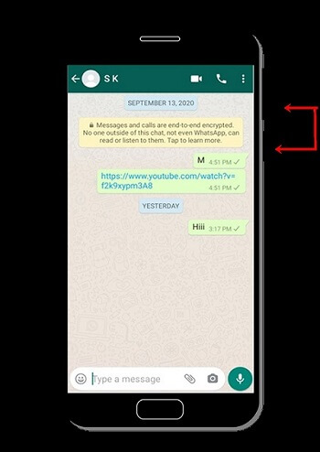
Tips for reporting to Police
Evidence: capture as much evidence as possible when it is happening –screenshots, screen recordings, make sure they have time stamps, downloading data from the platform about the interactions that are occurring.
“Capturing this evidence as soon as it happens is super helpful for investigations because sometimes that data and info can be gone by the time it is needed.” Cybercrime team, Avon & Somerset Constabulary

Slide 45

Reporting: Data, Consent & Timeframe
Police will try to retrieve the digital data from the suspects account/devices where possible. If not possible they will discuss possibility of retrieving from victims phone.
This can only be done with consent from the victim and will not be forced on them
This Data will be stored securely on police systems and only reviewed by investigating personnel.
If any personal data is to be used as evidence it will be redacted to safeguard private life (this should also be explained to victim)
Victim may be required to participate in video recorded interviews, consent forms, reviewing messages, documents, medical records, attending court.
No set timeframe and the response is based on risk/urgency of report
Delayed response does not mean the case is less serious

Slide 46

Reporting & Revenge Porn
Age Distinction: Any indecent image of a child under 18 is counted as Child Sexual Abuse Material (previously referred to as Child Pornography) and it is illegal to distribute these images or have them in your possession (even if the images were taken with consent and the person taking them is under 18). This is covered under ‘Protection of Children Act 1978’.
Recent public cases of Revenge Porn: Zara Mcdermott & Georgia Harrison. They both have documentaries around the subject. ‘Revenge Porn’ on Iplayer and ‘Revenge Porn: Georgia Vs Bear’ on ITV Player. https://www.itv.com/watch/revenge-porn-georgia-vs-bear/10a2232
StopNCII.org (Stop Non-Consensual Intimate Image Abuse) Global tool for victims of revenge porn that prevents intimate images from being shared online by perpetrators.

Slide 47

Social Media and Mental Health | Tips and Advice | YoungMinds

Slide 48


Tech Safety Tool & Home Tech Tool https://refugetechsafety.org/secure-your-tech/
Protecting yourself online https://www.getsafeonline.org/personal/article-category/protecting-yourself https://oursafetycentre.co.uk/ https://reportharmfulcontent.com/?lang=en https://reportharmfulcontent.com/advice/other/further-advice/faqs/
Professionals Online Safety Helpline | SWGfL https://criminalinjurieshelpline.co.uk/blog/securing-your-devices-after-you-leave-an-abusive-relationship https://www.thecyberhelpline.com/guides-2
Reporting Fraud https://www.actionfraud.police.uk/
Resources

Slide 49
Revenge porn & Sextortion
https://stopncii.org/
https://revengepornhelpline.org.uk/
https://www.avonandsomerset.police.uk/victims-witnesses-and-offenders/support-for-victims-of-sextortion/
Social media
Keep my social media private guide | Refuge Tech Safety
https://socialmediavictims.org/cyberbullying/types/flaming/
https://www.youngminds.org.uk/young-person/coping-with-life/social-media-and-mental-health/
Specific app safety centres
https://support.tiktok.com/en/safety-hc
https://about.instagram.com/safety
https://en-gb.facebook.com/help/443357099140264/?helpref=popular_articles
https://help.snapchat.com/hc/en-us/requests/new?lang=en-GB&start=5153567363039232
Visit our resources folder online for all these and more: TFA Resources

Slide 50

Thank you!

