Slide 1


INTRODUCING RELECTIVE PRACTICE
Clare Birch
1625 Independent People

Slide 2
Training Aims
Develop a common understanding of Reflective Practice
Explore the benefits of Reflective Practice in the context of our work

Slide 3

Who Is in the room today?

Slide 4

WHAT is Reflective Practice?
Reflective practice is the process of examining one’s own experiences to see what can be learned from them.

Slide 5

Discussion
In pairs or threes:
What does reflection mean to you?
When, where and how do you use reflection in your life currently?

Slide 6

Reflection as Learning
Reflection is a valuable way that we learn, and an important tool for recognising when things need to change.

Slide 7
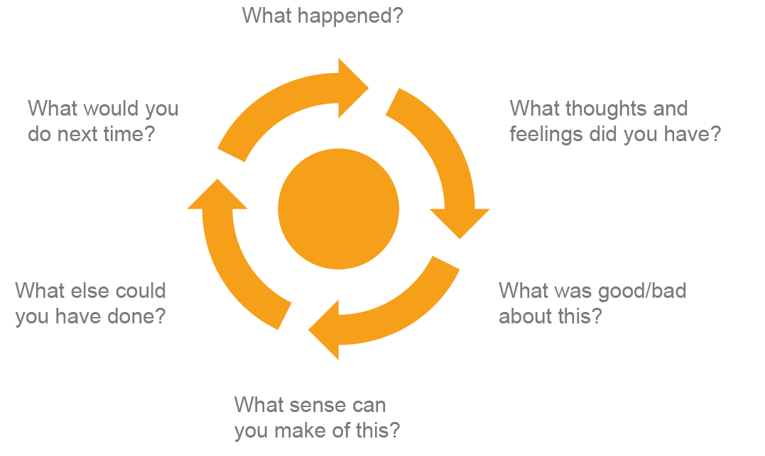
The Gibbs Model

Slide 8

Three Question Summary
What?
So What?
Now What?

Slide 9

Exercise
In pairs or threes:
Person 1 : think of something that happened to you this week
Person 2: ask Person 1 each of the questions in the Gibbs Model
Person 3: (optional) Listen and feedback

Slide 10
Group Reflective Practice
A safe environment in which practitioners can honestly assess their practice without fear of judgement or reprisal
Clear purpose
Safety and confidentiality
Ownership of the process

Slide 11
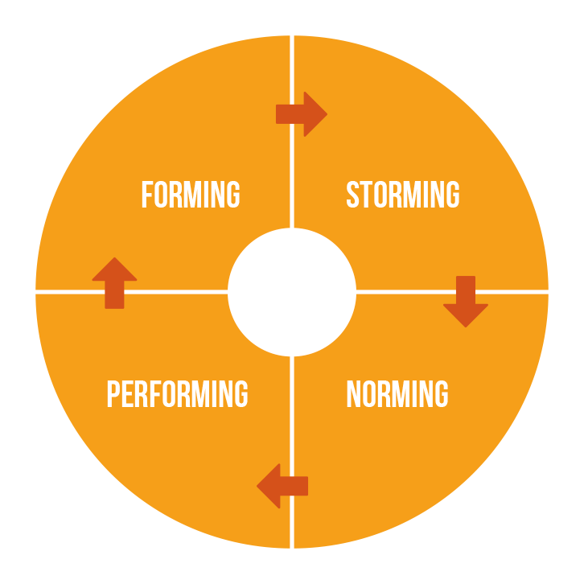
Group Development

Slide 12
Discussion
In pairs or small groups, discuss:
Do you have experience of belonging to a group or team which worked well together?
Can you identify with the stages of forming, storming, norming and performing?

Slide 13

The Role Of Facilitator
Set up the room and welcome the group
Enable all members of the group to take an active part in reflection
Prompt with questions where appropriate
Over time, assist the group to become self managing
Help the group keep to time

Slide 14
QUESTIONS?
Thanks for listening

